Slide 1

Tutorial on Speech-to-Speech Machine Translation
ICON2021
Presenters: Akshay Batheja, Rohit Kundu, Vineet Bhat, Shivam Mhaskar, Shyam Thombre, Sourabh Deoghare, Tamali Banerjee, Jyotsana Khatri,
and
Prof. Pushpak Bhattacharyya
IIT Bombay
Date: 19/12/2021

Slide 2
Contents
Speech-to-Speech Machine Translation (SSMT)
Automatic Speech Recognition (ASR)
Disfluency Correction (DC)
Machine Translation (MT)
Automatic Post Editing (APE)
Text-to-Speech (TTS)
SSMT Demo

Slide 3
Speech-to-Speech Machine Translation

Slide 4

Problem Statement
Speech-to-Speech Machine Translation : To translate speech in language A into speech in language B through use of a computer.
Speech-To-Speech Machine Translation System
Speech segment in L1
Speech segment in L2

Slide 5

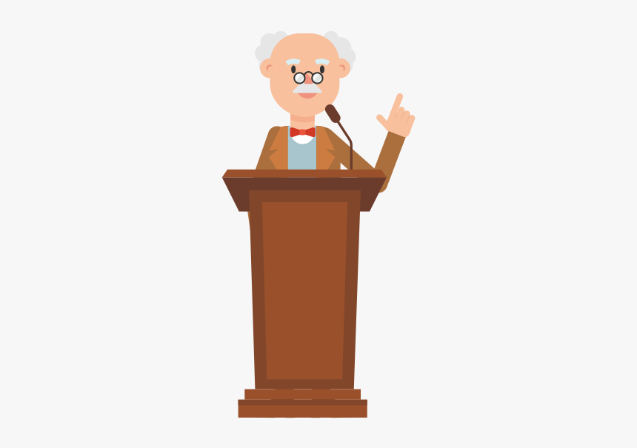

NLTM: Bahubhashak Project: Speech to Speech Machine Translation - Pipeline
When the Moon come in between the Sun and the Earth, solar eclipse happens.
When the Moon comes in between the Sun and the Earth, solar
eclipse happens.
Automatic Speech Recognition
Manual Editing
जब चंद्रमा सूर्य और पृथ्वी के बीच आ जाता है तो सूर्य
ग्रहण होता है
जब चंद्रमा सूर्य और पृथ्वी की बीच आ जाता है तो सूर्य
ग्रहण होता है
Manual Editing
Machine
Translation
Text to Speech

Slide 6
Motivation
SSMT technologies witnessing rapid growth:
Globalization, business needs, frequent travel, tourism industry fueling its demands.
Huge range of applications, examples:
Movie dubbing
Movie Subtitling
Conversing with foreign language speakers

Slide 7
SSMT Market: USD 330 million in 2020 → USD 600 million in 2026
Study Period: | 2018 - 2026
Base Year: | 2020
Fastest Growing Market: | Asia Pacific
Largest Market: | Europe
CAGR: | 9.4 %
https://www.mordorintelligence.com/industry-reports/speech-to-speech-translation#:~:text=The%20speech%20to%20speech%20translation%20market%20is%20valued%20at%20USD,period%20(2021%2D2026).

Slide 8
Benefits
Bridging the language gap in global commerce and cross-cultural communication
Aids communication between people speaking different languages
Education in mother tongue
Will dramatically reduce time for making Lectures available in Indian Languages
Skills development amongst youth
Technology could be scaled to school education
A promising solution for imparting quality school education in rural India

Slide 9
Challenges
Conversational Spontaneous Speech
It is a ahh umm beautiful day
Ill-formed and incomplete sentences
Indian English
Accent varies across the Nation
A problem for ASR
Word Ordering
Significantly different for English and Indian languages
A problem for MT
Code Switching
आज I am busy
Lip Syncing
Translated sentences to Indian Languages are usually longer.

Slide 10
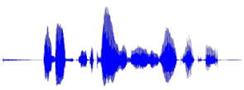
Cascaded SSMT Approach
ASR : Transcribing speech into text
MT : Translating text from language A to language B
TTS : Synthesizing speech from text
Automatic Speech Recognition
(ASR)
Machine Translation
(MT)
Text to Speech
(TTS)
Speech Signal
In language A
Text in
language A
Text in
Language B
Speech Signal
In language B

Slide 11
Well known Systems
US: Janus, DIPLOMAT, Tongues, Nespole! Maxtor
Europe: Verbmobil, Nespole! LC-Star, TC-Star
Japan: MATRIX NEC
China: LodeStar, Digital Olympics

Slide 12
SSMT: a Data Driven S2S problem
Training data for an end-to-end ST model is very scarce.
Available currently: only hundreds of hours of speeches, most of which are for
Japanese–English translation and European languages [102,103]
For Chinese–English translation, Baidu has released an open dataset containing 70 hours of speeches, including both the corresponding transcriptions and translations
Through MEITY funded speeech consortia led by IIT Madras, speech data in Indian lanaguges is now available

Slide 13
Direct Speech to Speech Machine Translation

Slide 14
Direct Speech to Speech MT
Problem Statement
To translate speech input in one language into speech in another language without relying on the intermediate step of text generation.
Motivation
Lower computational costs and inference latency as compared to the cascaded systems.
To provide a translation support for languages that do not have a writing system.

Slide 15
Previous Approaches
Cascaded S2S MT (2006) [2]
The Cascaded S2S pipeline consists of three components
ASR -> MT -> TTS
End-to-End S2T (Speech to Text) (2019) [3]
Alleviates the error propagation issue between ASR and MT
S2T can be combined with TTS to provide both Speech and Text translation

Slide 16
Recent Developments
Translatotron by Google AI (2019)
An attention-based sequence-to-sequence neural network which can directly translate speech from one language into speech in another language
Direct S2ST with Discrete Units by Facebook AI and Johns Hopkins University (2021) , state-of-the-art in Direct S2ST

Slide 17
Direct S2ST with Discrete Units (1/2)
Key Contributions:
Self-supervised discrete representations of target speech is predicted instead of mel spectrogram features.
Model jointly generates speech and text output by combining S2ST and S2T tasks through the shared encoder and a partially shared decoder, for the languages where the transcripts are available at source as well as at target.

Slide 18
Direct S2ST with Discrete units (2/2)
Key Contributions:
In the scenarios where the transcripts for target language is unavailable, Direct S2ST model is trained with multitask learning using discrete representations for the source and target speech.
The issue of length mismatch between the text and speech output during decoding is resolved using CTC (connectionist temporal classification).

Slide 19
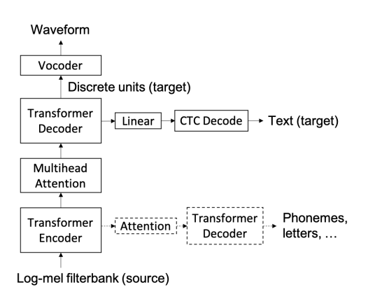
Model Architecture (1/2)
Transformer-based seq-to-seq model with a speech encoder and a discrete unit decoder and incorporates auxiliary tasks similar to translatotron during training to facilitate model learning.
Image source -Discrete Speech to Speech Translation [2]

Slide 20
Model Architecture (2/2)
For target languages with text transcripts, target text CTC decoding is applied conditioned on the intermediate representations from the discrete unit decoder.
This CTC decoding is used for jointly training text and speech.
A Vocoder is separately trained to convert discrete units into a waveform.

Slide 21
Direct S2ST Pipeline
English Speech Input
Speech To Unit Model
Discrete units of target speech are predicted,
K=10
[ 3,5,2,..]
The weather is cold today
Hindi Speech Output
Vocoder
आज मौसम ठंडा है

Slide 22
Speech to Unit (S2U) Model (1/2)
Generation of Discrete Units for the target language:
HuBERT model is trained on an unlabelled speech corpus of the target language.
The trained model is used to encode the target speech into continuous representations at every 20ms frame.
A k-means algorithm is applied on the learned representations to generate K cluster centroids.
These K cluster centroids are used to encode the target utterances into sequences of cluster indices at every 20 ms.

Slide 23
Speech to Unit (S2U) Model (2/2)
A target utterance y is represented as [ z₁, z₂, .., z_{T} ], where z_{i} belongs to {0, 1, 2, .., K-1}, K is the number of clusters and T is the number of frames.
S2U model is built by adapting from the transformer model for MT (Machine Translation).
A stack of 1-D convolutional layers, each with stride 2 and followed by a gated linear unit activation function, is prepended to the transformer layers in the encoder for downsampling the speech input.
As the target sequence is discrete, S2U model is trained with cross entropy loss with label smoothing.
Trained the Hi-Fi GAN neural vocoder for unit-to-waveform conversion.

Slide 24
Dataset used (1/2)
Fisher Spanish-English speech translation corpus
The dataset consists of 139k sentences from telephone conversations in Spanish, the corresponding Spanish text transcriptions and their English text translation.
Data Preparation:
A high-quality TTS engine is used to prepare synthetic target speech with a single female voice as the training targets.

Slide 25
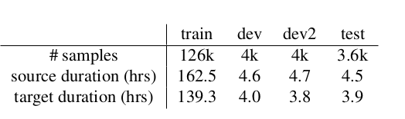
Dataset used (2/2)
Train, dev, test split:

Slide 26
Results (1/3)
Source and Target text transcripts are available:
For the systems with dual mode output (like cascaded and S2U + CTC ), both, the text output directly from the system and the ASR decoded text from the speech output, are evaluated.
Corpus | Models | Test (BLEU)
Fisher Spanish-English Speech Translation Corpus |  | Speech | Text
 | Translatotron + Pretrained encoder | 31.1 | -
 | Cascaded (S2T + TTS) | 39.5 | 41.5
 | S2U reduced + CTC (w/ sc,tc) | 37.2 | 39.4

Slide 27
Results (2/3)
Source text transcripts available but target text transcripts are unavailable:
All models are trained without using any target text transcripts.
Corpus | Models | Test (BLEU)
Fisher Spanish-English Speech Translation Corpus | Translatotron (w/ sp) | 7.2
 | S2U reduced (w/ sc) | 33.8

Slide 28
Results (3/3)
Both source and target text transcripts are unavailable:
All models are trained without using any text transcripts.
Corpus | Models | Test (BLEU)
Fisher Spanish-English Speech Translation Corpus | Translatotron no auxiliary task | 0.6
 | S2U reduced (w/ su) | 27.1

Slide 29
Summary
In scenario where text transcripts are available at source as well as target, S2U reduced model with joint speech and text training and auxiliary tasks, has bridged 83% of the gap between transformer-based Translatotron and the S2T+TTS cascaded baseline.
Also demonstrated the possibility of translating between two unwritten languages by taking advantage of discrete representations of both the source and the target speech for model training.

Slide 30
Comparing Direct S2ST with Cascaded approach
Advantages | Disadvantages
Cascaded system have problem of errors compounding between components e.g. Recognition errors leading to larger translational errors. Direct S2ST model does not face such issues. | A large set of Input/Output speech pairs are required which are more difficult to collect than parallel text pairs for MT.
Reduced computational requirements and lower inference latency. | Cascaded S2ST is more robust.
Paralinguistic and Non-linguistic information is retained during translation. | Uncertain alignment between two spectrograms whose underlying spoken content differs also poses a major training challenge.

Slide 31
References
[1] Ye Jia and Ron J. Weiss and Fadi Biadsy and Wolfgang Macherey and Melvin Johnson and Zhifeng Chen and Yonghui Wu. 2019. Direct speech-to-speech translation with a sequence-to-sequence model. In Interspeech.
[2] Ann Lee and Peng-Jen Chen and Changhan Wang and Jiatao Gu and Xutai Ma and Adam Polyak and Yossi Adi and Qing He and Yun Tang and Juan Pino and Wei-Ning Hsu. 2021. Direct speech-to-speech translation with discrete units. In Interspeech.
[3] Mattia Antonino Di Gangi, Matteo Negri, Marco Turchi. 2019. One-to-many multilingual end-to-end speech translation. IEEE
[4] Satoshi Nakamura, Konstantin Markov, Hiromi Nakaiwa, Genichiro Kikui, Hisashi Kawai, Takatoshi Jitsuhiro, Jin-Song Zhang, Hirofumi Yamamoto, Eiichiro Sumita, and Seiichi Yamamoto. The ATR multilingual speech-to-speech translation system. 2006. IEEE

Slide 32
Automatic Speech Recognition

Slide 33
Topics to be covered in ASR
A general introduction to ASR: Problem statement to mathematical description
Discussion regarding the Hidden Markov Model based approach to ASR
Introduction to Deep Learning based ASR
Techniques for developing good quality speech recognition systems for Indian languages
Code walkthrough for a SOTA training and evaluation pipeline for English ASR + Demo for Hindi ASR

Slide 34
Automatic Speech Recognition
ASR is the task of using algorithms and methodologies to enable translation of speech signals to text by computers.
Research has developed from 1960s to 2020s
Speech recognition technologies have wide scale use in education, software development, utilities, luxury, military, etc.
Well known examples: YouTube closed captioning, Voicemail transcription, Dictation Systems, etc

Slide 35
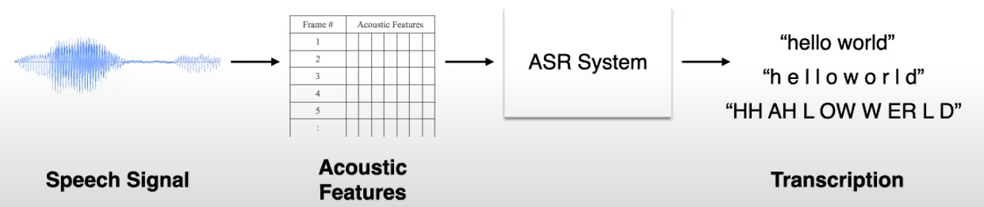
Simplified pipeline of an ASR System
Image source: Lectures on Automatic Speech Recognition by Prof Preethi Jyothi, Course CS753, IIT Bombay

Slide 36
Motivation
ASR Research has gained momentum over the years with the advent of faster computation and better resources
Extensive data collection across widely spoken languages
Disparity in Data availability for regional languages
Innovative methods such as Transfer Learning and Knowledge sharing yet to be explored fully

Slide 37
Prior Work (Pre-Deep Learning era)
Audrey by Bell Labs(1952): Digit Recognizer
Shoebox by Bell Labs(1962): Isolated word Recognizer
Harpy by Carnegie Mellon(1970s): 1000 words recognizer
HMM in Speech Recognition
Introduction of Deep Learning in ASR (2010s)
Dictate MCA by Dragon Inc (1980s) Typing documents through speech
Notes:
1952

Slide 38
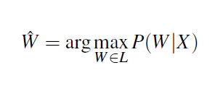
Mathematical Description of ASR
We treat the acoustic input signal as X = {x₁ , x₂ , x₃ , x₄ , . . . } a series of observations and define a sequence of words as the desired output W = {w₁ , w₂ , w₃ , w₄ , . . . }
Essentially, we are interested in obtaining the following -

Slide 39
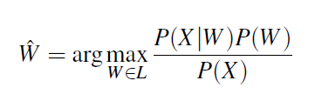
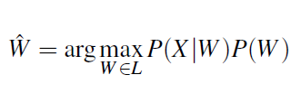
We can use Bayes rule to rewrite this as -
P(X|W) : Probability of occurrences X given words W (Acoustic Models)
P(W): Probability associated with word sequence (Language Models)

Slide 40
Acoustic Models:
Contains statistical representations of each of the distinct sounds that make up a word
44 phonemes in English, each phoneme has its own HMM
Lexicon Models:
Pronunciation models for speech recognizers; provides discriminating metric between pronunciations of the same word in different context
Eg, consider “ough” as in through, dough, cough, rough, bough, thorough, enough, etc
Language Models:
Predicting next word given a sequence of words
Used to calculate P(W) in previous expressions

Slide 41
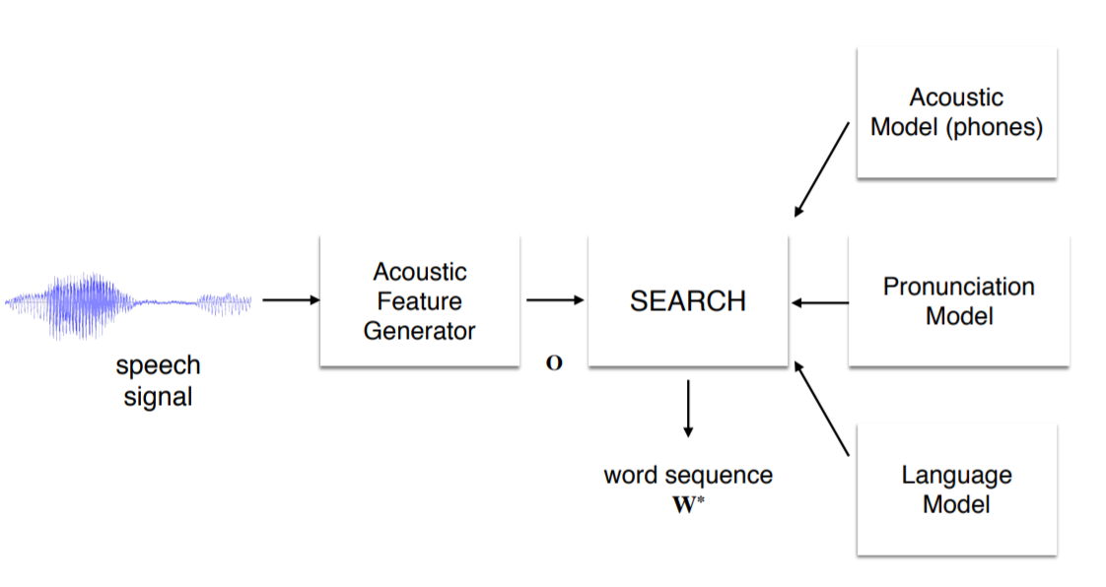
Architecture of cascaded ASR System
Image source: Lectures on Automatic Speech Recognition by Prof Preethi Jyothi, Course CS753, IIT Bombay

Slide 42
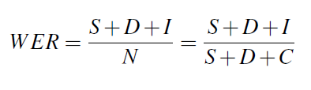
Evaluation Metrics for ASR
Characteristics of a good ASR Metric:
Direct
Objective
Interpretable
Modular
Word Error Rate: Popular metric; measures the percentage of corrections needed to transform an incorrect word to a correct word.

Slide 43
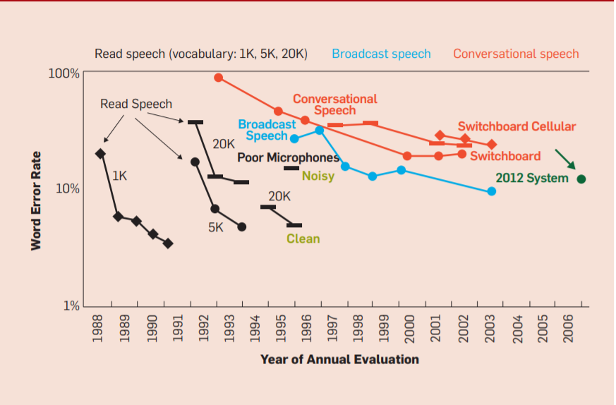
ASR Error rates across the years
Image Source: A Historical Perspective of Speech Recognition, Communications of the ACM, 2014

Slide 44
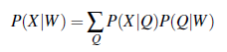
Hidden Markov Models
Each spoken word consists of a sequence of ‘l’ pronunciation segments called phonemes
To compute over all possible pronunciations Q of the word, we model the probability as -

Slide 45
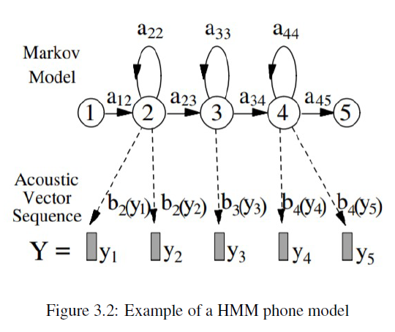
Each base phoneme q is modelled as a HMM as depicted in the figure below -

Slide 46
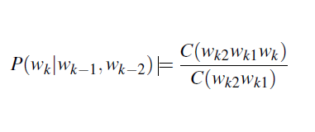
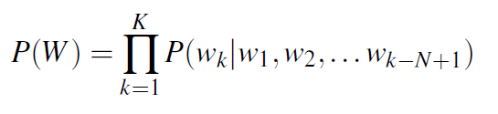
For a large vocabulary, including the dependence on all previous words in the sentence becomes computationally difficult task.
As a result, N-gram models were constructed such that the dependence is limited to the last N words of the sequence -

Slide 47
Viterbi Algorithm:
Identifying the sequence of hidden variables given observed sequence
Calculates the probability of the various possible outputs of the current time step keeping into account the associated probabilities of the previous time step outputs
At each timestep we have a probability associated with all the possible paths in the decoding.
The path with the highest probability is assigned as the Viterbi path and is continued forward to the next time step.

Slide 48
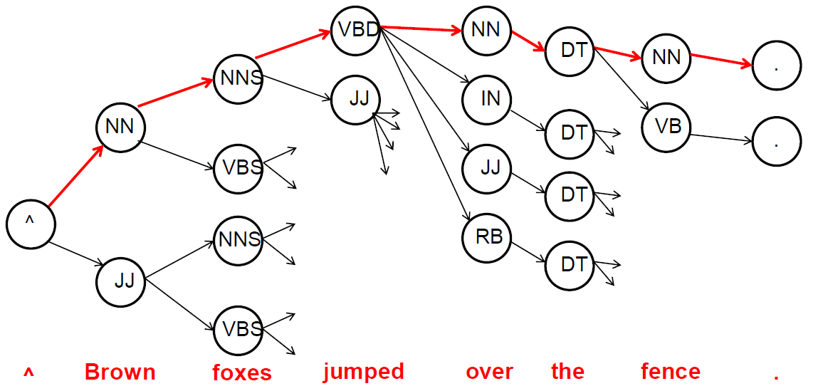
A short digress: Viterbi decoding for Part of Speech (POS) tagging
Image source: Lectures on Speech and NLP by Prof Pushpak Bhattacharyya, Course CS626, IIT Bombay

Slide 49
End-to-End Deep Learning Based ASR Systems
Shortcomings of HMM ASR Systems:
Local optimization of these models does not imply global optimization of the entire pipeline
Modules are difficult to train and often require a lot of manual and domain specific feature engineering to achieve good results specific to the domain chosen
Demand a large amount of annotated and aligned speech-text corpus.
Compounding Errors problem

Slide 50
Demonstrating the power of E2E Models
Three types of E2E systems - 1) CTC-Based Models, 2) RNN Transducer and 3) Attention-Based models
 | dev | test
DNN - HMM | 5.0 | 5.8
E2E (Attention) | 14.7 | 14.7
 | dev | test
DNN - HMM | 4.0 | 4.4
E2E (Attention) | 4.7 | 4.8
Results on Librispeech-100 corpus
Results on Librispeech-960 corpus
Results taken from “RWTH ASR Systems for LibriSpeech: Hybrid vs Attention”, Christoph et al, 2019

Slide 51
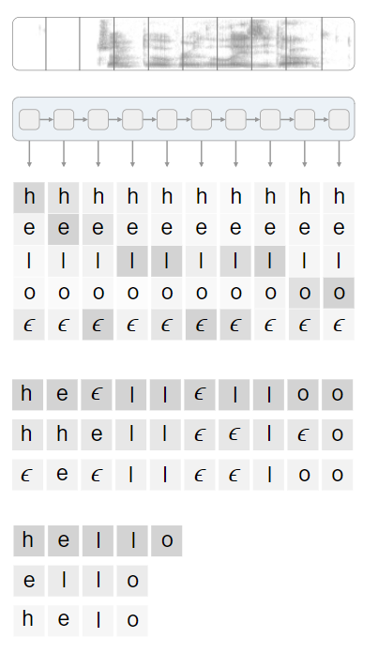
CTC Based ASR Models
A loss function but it solves the alignment problem while computing its loss function.
CTC attempts to solve the data alignment problem as alignment between segments and audio is no longer needed.
CTC uses the higher dimensional features learnt through DNNs to directly map audio inputs to hypothesis segments.
Image Source: A blog on Sequence Modeling With CTC - https://distill.pub/2017/ctc/

Slide 52
RNN - Transducer Model
RNN encoder, analogous to an acoustic model, maps input audio features x to hidden representations h^{e}
The prediction network takes as input the previous output label prediction w^{u} and maps it to to a hidden representation h^{p}
The joint network takes the encoder representation h^{e} and the prediction network representation h^{p}
Produces joint logits z which are softmax normalized to provide an output distribution over over the output label space and blank symbol

Slide 53
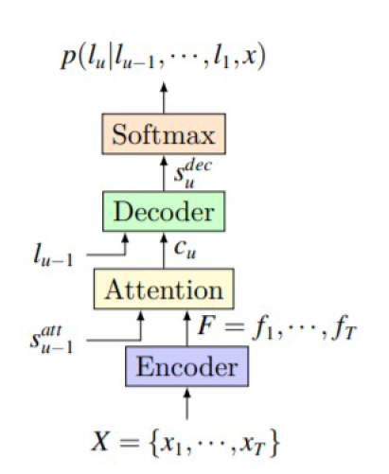
Attention Based ASR Models:
Encoder model maps the input audio signal to a sequence of vectors instead of one fixed vector
The decoder then assigns weights to these sequence of vectors while concatenating them to decode the higher dimensional features
Thus at each time step, the previous as well as the future time step features are taken into account while decoding the particular character and alignment.
Image Source: Deep Context: End-to-End Contextual Speech Recognition, Pundak et al, 2018

Slide 54
Understanding Speech Data
Characteristics of a good ASR dataset:
Noise Robustness: Presence of sufficiently noisy data for model to learn features with noise
Diversity: Covering various accents and pronunciations
Bias in ASR:
ASR unable to recognize and translate the speech impairment and children speech
Voice assistants perpetuate a racial divide by misrecognising the speech of black speakers more often than of white speakers

Slide 55
Common Pre-processing Steps
Speech:
Using denoising libraries to reduce background noise by isolating vocals
Text:
Indian languages Text data must follow ‘utf-8’ encoding
Removing punctuation marks
Numbers written in text format

Slide 56
Low Resource ASR
Low resource languages lack sufficient data to facilitate research and development of intelligent models. Most Indian languages belong to this category
Recent studies have shown that when DNNs are trained with speech signals from multiple languages, the features learnt are of high quality for downstream tasks.
These features produce better results for speech recognition compared when the DNN is only trained on the data of a low resource language, which is often extremely less to reach optimization

Slide 57
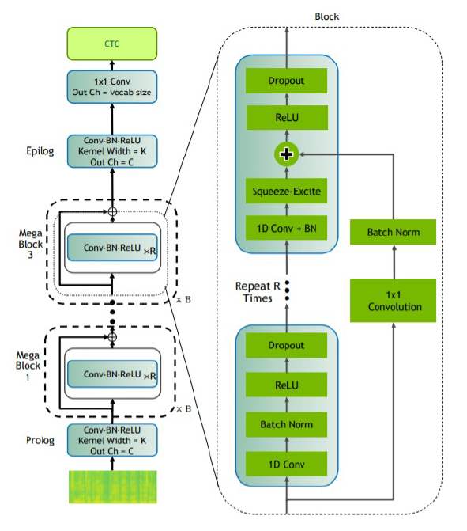
Citrinet512: Transfer learning in ASR (Part of Nvidia’s NeMo Research) (1/1)
Citrinet512 is a CTC Based Model
Contains 1D Convolutional layers with various blocks
Each block consists of Convolutional layers, Batch Normalization, ReLU and Dropout
Image Source: Citrinet: Closing the Gap between Non-Autoregressive and Autoregressive End-to-End Models for Automatic Speech Recognition, Majumdar et al, 2021

Slide 58
Citrinet512: Transfer learning in ASR (Part of Nvidia’s NeMo Research) (2/2)
An additional Squeeze and Excite (SE) layer is also present which improves the representational power of a network by modelling the inter-channel dependencies of convolutional networks.
Citrinet512 model can be used as a pretrained checkpoint(training on Eng speech) followed by finetuning for Hindi or any other Indian Language
Finetuning is performed by replacing the vocabulary in the decoder with Devanagiri characters

Slide 59
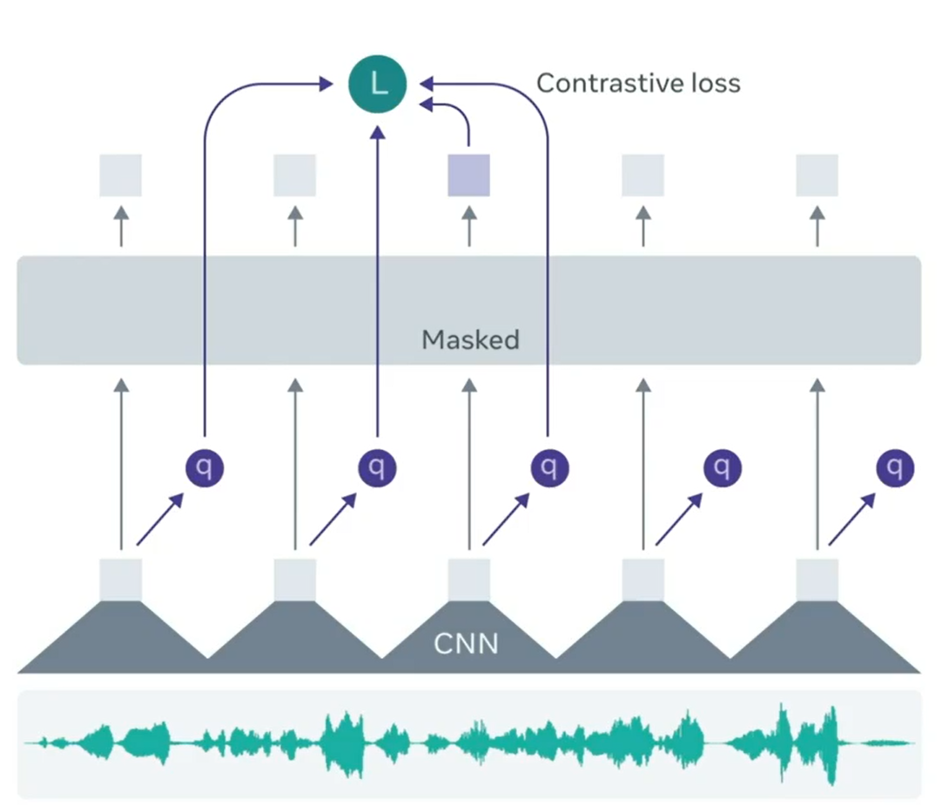
Wav2vec: Learning Speech representations from Audio
Uses raw audio to learn speech features
Masks spans of speech representations
Training objective is to recover the masked audio through the context
Image Source: https://ai.facebook.com/blog/wav2vec-20-learning-the-structure-of-speech-from-raw-audio/

Slide 60
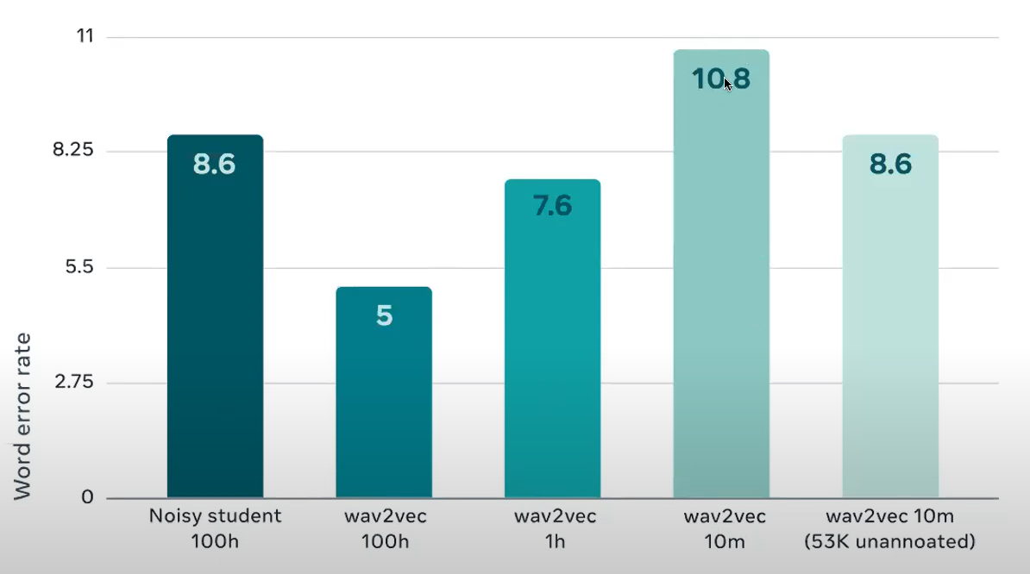
Results of wav2vec
Image Source: https://ai.facebook.com/blog/wav2vec-20-learning-the-structure-of-speech-from-raw-audio/

Slide 61
Finetuning Wav2Vec 2.0 model for multilingual ASR
The XLSR Wav2Vec2 model is presented by Facebook AI in “Unsupervised Cross Lingual Representation Learning for Speech Recognition“ - Conneau et al, 2020
XLSR stands for Cross-Lingual Speech Representations and refers to XLSR-Wav2Vec2’s ability to learn speech representations that are useful across multiple languages
XLSR-Wav2Vec2 learns powerful speech representations from hundreds of thousands of hours of speech in more than 50 languages(including Hindi) of unlabeled speech

Slide 62
CLSRIL-23: Pretraining wav2vec 2.0 on Indian Languages ASR Data, July 2021
Authors use wav2vec 2.0 to pretrain on 9k+ hours of unsupervised speech using 23 Indian Languages followed by finetuning in each of these languages
Comparison of a monolingual approach and multilingual approach is performed by analysing a model pretrained only on Hindi and a model pretrained on multiple languages

Slide 63
Comparing both the approaches
Training time for wav2vec 2.0 is much longer than the Citrinet512 model. For wav2vec 2.0, each epoch took about 1.5 hours for training whereas for Citrinet512, it took about 15 min.
Possible Reason: wav2vec 2.0 is a transformer based approach whereas Citrinet512 is a convolutional model, performing faster with a GPU
Ability of the Citrinet512 is able to output punctuation marks much better than wav2vec 2.0

Slide 64
ASR DEMO

Slide 65
Summary of ASR
Historical view of the ASR problem statement and the progress made in the last 70 years
Understanding the traditional HMM models, its strengths and its weaknesses and how it paved the way for E2E systems
Appreciating the state-of-the-art E2E system for ASR: wav2vec and multilingual training for low resource ASR
Demo for English and Hindi ASR using this SOTA

Slide 66
Disfluency Correction

Slide 67
Disfluency
Speakers often use filler words, repeat fluent phrases, suddenly change the content of speech, and make corrections in their statement. These are some common disfluencies. Also, speakers use words like ”yeah”, ”well”, ”you know”, ”alright” etc. which do not contribute to the semantic content of the text but are only used to fill pauses or to start a turn, are considered to be disfluent.
Example: Well, this is this is you know a good plan.

Slide 68
Motivation
Disfluency is a characteristic of spontaneous speech which is not present in written texts
It reduces the readability of speech transcripts
It also poses a major challenge to downstream tasks e.g. machine translation
Since MT models are usually trained on fluent clean corpora, the mismatch between the training data and the actual use case decreases their performance.
To tackle this challenge, specialized disfluency correction models are developed and applied as a post-processing step to remove disfluencies from the output of speech recognition systems

Slide 69
Disfluency Correction
Disfluency Correction Model
Well, this is this is you know a good plan
this is a good plan
Disfluent text
Fluent text

Slide 70
Types of Disfluencies (1/2)
Type | Description | Example
Filled Pause | Non lexicalized sounds with no semantic content. | but uh we have to go through the same thing.
Interjection | A restricted group of non lexicalized sounds indicating aﬀirmation or negation. | uh-huh, I can understand the issue.
Discourse Marker | Words that are related to the structure of the discourse in so far that they help beginning or keeping a turn or serve as acknowledgment. They do not contribute to the semantic content of the discourse. | Well, this is a good plan.

Slide 71
Types of Disfluencies (2/2)
Type | Description | Example
Repetition or Correction | Exact repetition or correction of words previously uttered. | If if I can’t don’t know the answer myself, I will find it.
False Start | An utterance is aborted and restarted with a new idea or train of thought. | We’ll never find a day what about next month?
Edit | Phrases of words which occur after that part of a disfluency which is repeated or corrected afterwards or even abandoned completely, to indicate that the previously uttered words are not intended. | We need two tickets, I’m sorry, three tickets for the flight to Boston.

Slide 72
Disfluency: Surface Structure (1/2)
Reparandum
contains those words, which are originally not intended to be in the utterance
Interruption point
marks the end of the reparandum
Interregnum
consists of an editing term or a filler
Repair
words from the reparandum are finally corrected or repeated here or a complete new sentence is started

Slide 73
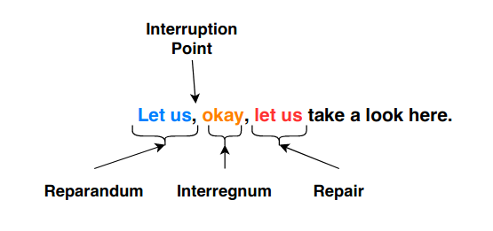
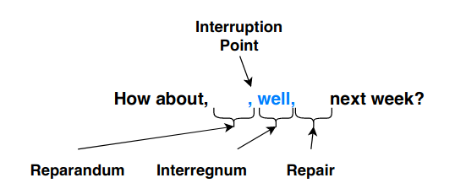
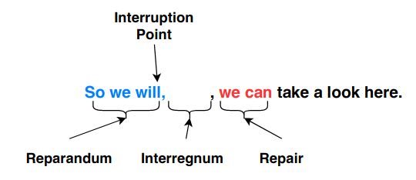
Disfluency: Surface Structure (2/2)
Image source: Saini et al. [4]

Slide 74
Dataset (1/2)
SwitchBoard English Disfluency Correction corpus.
Split | No of Sentence
Train | 55482
Validation | 11889
Test | 11889

Slide 75
Dataset (2/2)
SwitchBoard English Disfluency Correction corpus.
Disfluent Sentence | Fluent Sentence
well i i just live in a i live in an apartment now | i live in an apartment now
it's a it's a fairly large community | it's a fairly large community
and so uh you know i'm kind of spoiled | i'm kind of spoiled

Slide 76
Data Preprocessing
Lower-case
Normalization
Punctuation removal
Apply Byte-Pair Encoding (BPE)

Slide 77
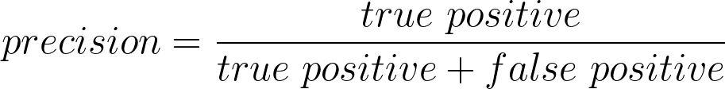
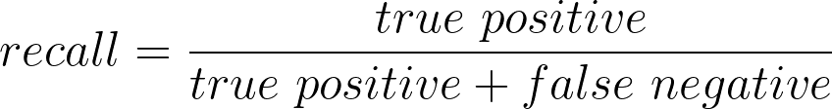
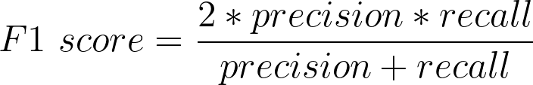
Evaluation
BLEU score
Precision, Recall, F1 score (for disfluency detection)
Human evaluation
Disfluent words are dropped
Fluent words are retained

Slide 78
Sequence to Sequence
Model the problem as a Translation task as if
Disfluent Sentence: Sentence in language 1
Fluent Sentence : Sentence in language 2
Performance on SWBD Testset: 95.01 bleu score

Slide 79
Usage of Joint BPE
Using different BPE vocabulary at source and target sides, model achieved 94.70 bleu score on test set
Use of joint BPE vocabulary (from the concatenated corpus of disfluent sentences and fluent sentences) improved the performance to 95.01

Slide 80
Style Transfer (1/3)
Unsupervised: works without any parallel data (fluent, disfluent pairs)
For every mini-batch of training, soft translations for a domain are first generated
Subsequently they are translated back into their original domains to reconstruct the mini-batch of input sentences.
The sum of token-level cross-entropy losses between the input and the reconstructed output serves as the reconstruction loss.

Slide 81
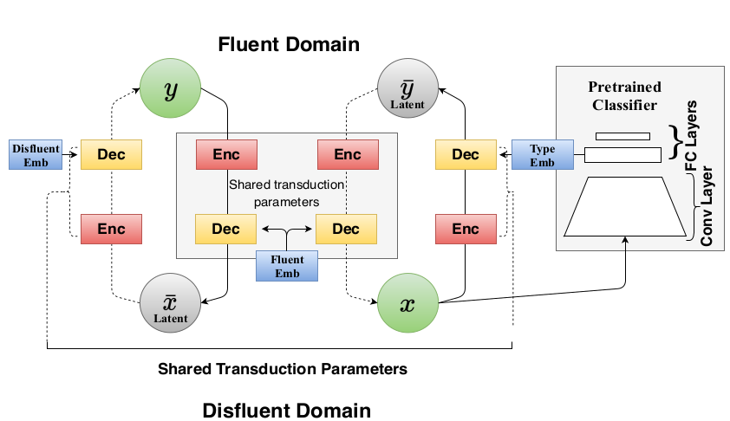
Style Transfer (2/3)
Image Source: Saini et al. [3]

Slide 82
Style Transfer (3/3)
It consists of a single encoder and a single decoder
Since we are only operating on the English language in the source (disfluent) and target (fluent), it is important to utilize the benefit of parameter sharing.
Single encoder and single decoder are used to translate in both directions, i.e., from disfluent to fluent text and vice-versa.
The decoder is additionally conditioned using a domain embedding to convey the direction of translation, signifying whether the input to the encoder is a fluent or disfluent sentence.

Slide 83
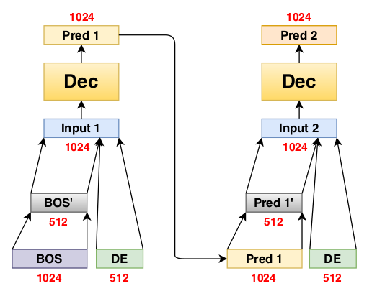
Domain Embedding
Dimensionality reduced word embedding is concatenated with the domain embedding DE at every time-step(t) to form the input for the decoder.
Image Source: Saini et al. [3]

Slide 84
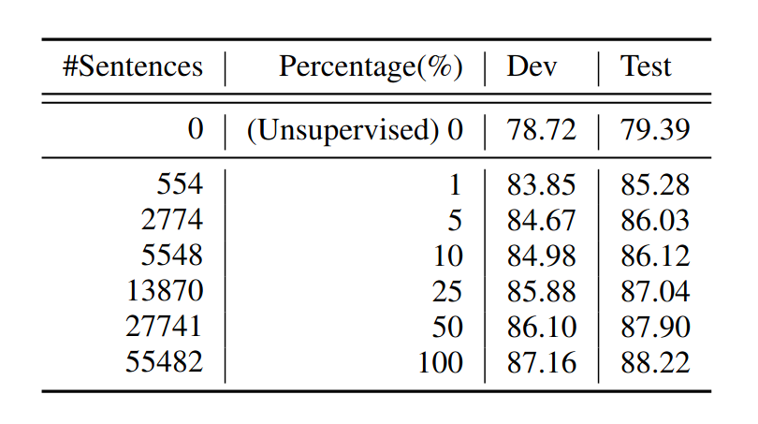
Disfluency Correction using Unsupervised and Semi-supervised Learning: Results
Image Source: Saini et al. [3]

Slide 85
Disfluency Detection
Detect the disfluent words in the sentences
Remove those disfluent words from the disfluent sentence
We would get the fluent sentence
Image Source: Saini et al. [4]

Slide 86
Disfluency Removal
Detect the disfluent words in the sentences
Remove those disfluent words from the disfluent sentence
We would get the fluent sentence
Disfluent: this is this is you know a big problem
Fluent: this is a big problem

Slide 87
Sequence Tagging
We tag each of the words as disfluent or fluent.
0 corresponds to fluent and 1 corresponds to disfluent.
Train model on the sequence tagging task
Disfluent: this is this is a big problem
Fluent: this is a big problem
Tags: 1 1 0 0 0 0 0

Slide 88
Synthetic Data: Motivation
Disfluency phenomenon is clearly visible in the Indian languages.
But due to the unavailability of disfluency correction dataset, it is not possible to train models.
This motivates the work of disfluency correction without any real parallel data.

Slide 89
Rule-based Disfluency Generation
Pronoun phrase repetition
Original fluent sentence: i was saying that we should go for a movie
Disfluent sentence: i was i was saying that we should go for a movie
Insertion of filler words
Original sentence: the new year is looking grim
Disfluent sentence: ah ah the new year is looking grim
Example Source: https://aclanthology.org/2020.iwslt-1.22.pdf

Slide 90
Few Rules for Bengali (1/6)
Randomly insert frequent filler words
Bn: বাপু-র নেতৃত্বে মানে পরিচালিত ঐতিহাসিক জন-আন্দোলন 'চম্পারনসত্যাগ্রহ'-এর প্রভাব ছিল সুদূর প্রসারিত।
Transliteration: vApu-ra netRRitve mAne parichAlita aitihAsika jana-Andolana 'champAranasatyAgraha'-era prabhAva Chila sudUra prasArita|
En: The historical mass movement ’Champaran Satyagraha’, I mean conducted under the leadership of Bapu, had a far-reaching effect.

Slide 91
Few Rules for Bengali (2/6)
Word Repetition
Bn: সেজন্যই আমরা আপনাদের সহযোগিতায় দেশের সকল জমির জন্য 'মৃত্তিকা স্বাস্থ্য কার্ড' চালু চালু করার অভিযান শুরু করেছি।
Transliteration: sejanyai AmarA ApanAdera sahayogitAya় deshera sakala jamira janya 'mRRittikA svAsthya kAr.Da' chAlu chAlu karAra abhiyAna shuru kareChi|
En: That is why we have started the campaign to introduce introduce 'Soil Health Card' for all the lands of the country with your cooperation.

Slide 92
Few Rules for Bengali (3/6)
Synonym correction
Bn: আজ আমরা খবরের কাগজের সংবাদপত্রের কথায়- সশস্ত্র বাহিনীকে তাদের ইচ্ছামতো কাজের পূর্ণ স্বাধীনতা দিয়েছি।
Transliteration: Aja AmarA khavarera kAgajera saMvAdapatrera kathAya়- sashastra vAhinIke tAdera ichChAmato kAjera pUrNa svAdhInatA diya়eChi|
En: Today, in the words of the news paper newspaper, we have given the armed forces full freedom to do whatever they want.

Slide 93
Few Rules for Bengali (4/6)
Missing syllables
Bn: ওড়িশার সার্বিক উন্নয়নে কেন্দ্রীয় সরকারের প্রতিশ্রুতিদ্ধতার প্রতিশ্রুতিবদ্ধতার কথা পুনর্ব্যক্ত করেন প্রধানমন্ত্রী।
Transliteration: o.Da়ishAra sArvika unnaya়ne kendrIya় sarakArera pratishrutivaddhatAra pratishrutivaddhatAra kathA punarvyakta karena pradhAnamantrI|
En: The Prime Minister reiterated the central government's commitment to the overall development of Orissa.

Slide 94
Few Rules for Bengali (5/6)
Pronoun Correction
Bn: সন্ত্রাসবাদের হুমকি যেভাবে দিন দিন বেড়ে চলেছে, তাকে না তার মোকাবিলায় সম্ভাব্য পদক্ষেপ গ্রহণের বিষয়গুলি সম্পর্কেও আলোচনা করেন দুই প্রধানমন্ত্রী।
Transliteration: santrAsavAdera humaki yebhAve dina dina ve.Da়e chaleChe, tAke nA tAra mokAvilAya় sambhAvya padakShepa grahaNera viShaya়guli samparkeo AlochanA karena dui pradhAnamantrI|
En: The two Prime Ministers also discussed the possible steps to be taken to counter the growing threat of terrorism.

Slide 95
Few Rules for Bengali (6/6)
Use part of word before the actual word
Bn: কিন্তু প্রোমো প্রোমোটারচক্রের ফাঁদে পড়ে ঠকে যান।
Transliteration: kintu promo promoTArachakrera phA.Nde pa.Da়e Thake yAna|
En: But fall into the trap of the promo promoter cycle.

Slide 96
Summary
Disfluency correction is a crucial step in SSMT pipeline
It removes irregularities from speech transcriptions and make that ready for Machine Translation
We are able to build DC systems with parallel data or monolingual data (in both domains) along with little amount parallel data
Model trained on artificially generated data has limitations
It would be interesting to take help from other languge’s disfluency correction data

Slide 97
Disfluency Correction Demo
https://www.cfilt.iitb.ac.in/speech2text/

Slide 98
References
[1] Matthias Honal and Tanja Schultz. 2003. Correction of Disfluencies in Spontaneous Speech using a Noisy-Channel Approach. In Interspeech.
[2] John Godfrey and Edward Holliman. 1993. Switchboard-1 release 2 LDC97S62. Published by: Linguistic Data Consortium, Philadelphia, USA.
[3] Nikhil Saini, Drumil Trivedi, Shreya Khare, Tejas Dhamecha, Preethi Jyothi, Samarth Bharadwaj, and Pushpak Bhattacharyya. 2021. "Disfluency Correction using Unsupervised and Semi-supervised Learning." In Proceedings of the 16th Conference of the European Chapter of the Association for Computational Linguistics: Main Volume, pp. 3421-3427.
[4] Nikhil Saini, Preethi Jyothi and Pushpak Bhattacharyya, Survey: Exploring Disfluencies for Speech To Text Machine Translation.
[5] Vicky Zayats, Mari Ostendorf, and Hannaneh Hajishirzi. 2016. Disfluency detection using a bidirectional LSTM. CoRR, abs/1604.03209

Slide 99
Machine Translation

Slide 100
Content
Introduction
Foundations
MT Paradigms
Neural Machine Translation
LaBSE Filtering
Latest Developments
Pivoting
Phrase Table Injection
Back-Translation
Multilingual NMT
Unsupervised NMT
Demonstration

Slide 101
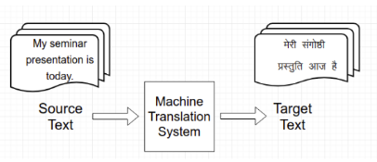
What is Machine Translation?
Automatic conversion of text from one language to another
Preserve the meaning
Fluent output text

Slide 102
History of MT
1954: First public demo of MT by IBM
Georgetown IBM experiment
1956: First MT conference
1972: Logos MT system
Translating military manuals into Vietnamese
Rule based approach
1993: Statistical MT
IBM models
2013: Neural Machine Translation

Slide 103
Why MT is hard?

Slide 104
Why MT is hard?
Language Divergence

Slide 105
Language divergence
Languages express meaning in divergent ways
Syntactic divergence
Arises because of the difference in structure
Lexical semantic divergence
Arises because of semantic properties of languages

Slide 106
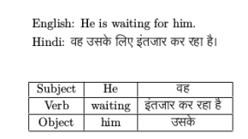
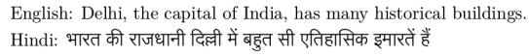
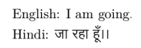
Different kinds of syntactic divergence
Constituent order divergence (Word order)
Adjunction divergence
Null subject divergence

Slide 107
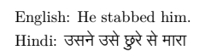
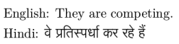
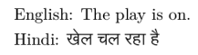
Different kinds of lexical semantic divergence
Conflational divergence
Categorial divergence (Lexical category change)
Head-swapping divergence (Promotion or demotion of logical modifier)

Slide 108
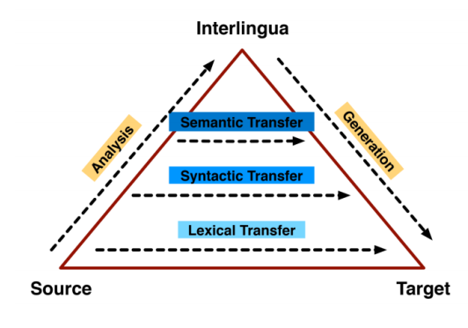
The Vauquois Triangle
Image source: http://www.cs.umd.edu/class/fall2017/cmsc723/slides/slides15.pdf

Slide 109
MT Paradigms

Slide 110
Different paradigms of Machine Translation
Rule based Machine Translation
Statistical Machine Translation
Example based Machine Translation
Neural Machine Translation

Slide 111
Rule based Machine Translation
Linguists create rules
Three types
Direct
Map input to output with basic rules
Transfer based
Direct + Morphological and Syntactic analysis
The level of transfer is dependent on the language pairs
Interlingua based
Use an abstract meaning
Interlingua: Represent meaning of text unambiguously
It works at the highest level of transfer
Performance of system highly dependent on experts who are creating rules

Slide 112
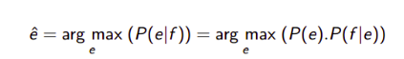
Statistical Machine Translation
Learning from parallel corpora
Three important things
Word translation
Word alignment
Word fertility management
Problem to solve for SMT
e is target language sentence, f is source language sentence, P(e) is language model in target language and P(f|e) is translation model.

Slide 113
Example based Machine Translation
Focus is on: Analogy
Based on textual similarity
Process
Analysis
Phrasal fragments of the input sentence
Transfer
Finding the aligned phrases from the database of examples
Generation
Recombination (Stitch together the aligned phrases)

Slide 114
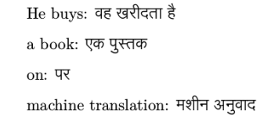
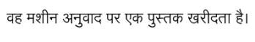
Example based Machine Translation: Example
He buys a book on Machine Translation.
Phrasal fragments: He buys, a book, on, Machine Translation
Aligned phrases: Identifies the aligned phrases from the database
Recombination: Recombine those phrases to construct a sentence (Adjusting morphology, reordering)

Slide 115
Phrase based Statistical Machine Translation
Why?
Translation of phrases is more intuitive
Process involved
Two-way alignment
Using SMT (eg. IBM model 1)
Symmetrization
Expansion of aligned words to phrases (Phrase table construction)

Slide 116
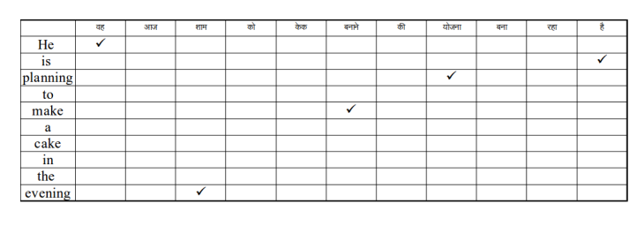
Phrase based SMT: English to Hindi alignment

Slide 117
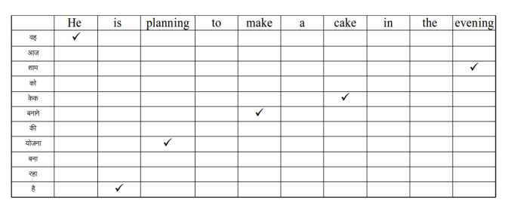
Phrase based SMT: Hindi to English alignment

Slide 118
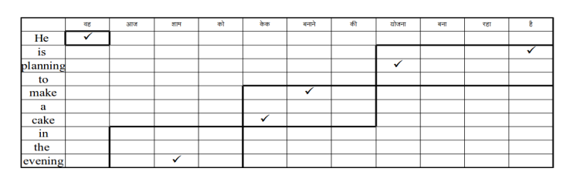
Phrase based SMT: Phrase generation
Principle of coverage: Every word must be in a phrase
Principle of non-vacuousness: No empty phrases
Principle of consistency:The aligned phrases must be consistent in the sense all words of phrase in source languages

Slide 119
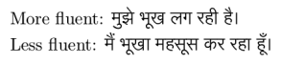
MT Evaluation
Manual evaluation
Quality of sentence depends on two factors
Adequacy
How faithful the meaning of a sentence is transferred
Fluency
Acceptability of the native speaker
Automatic evaluation measures
Word/phrase matching based
Edit distance based
Ranking based

Slide 120
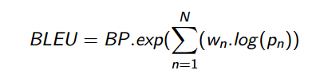
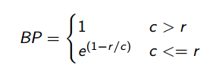
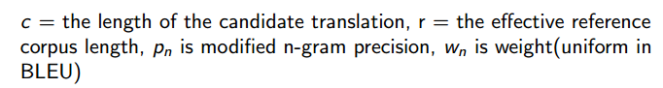
BLEU score
Bilingual Evaluation Understudy
Word/Phrase matching based
BP is brevity penalty, to penalize based on the length of the generated sentence.

Slide 121
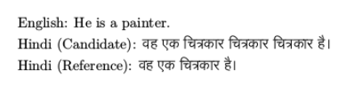
BLEU score: Example
Example:
1-gram precision is 1.
Modified 1-gram precision is 4/6.
The ratio of the number of phrases of length n present in candidate translation that are also present in reference translation and total number of phrases of length n in candidate translation.
In modified n-gram precision maximum count from reference translation

Slide 122
Neural Machine Translation

Slide 123
Why Neural Machine Translation?
In RBMT, EBMT, and SMT, there is no notion of similarity or relationship between symbolic representation of individual words.
Ability to translate I go to school does not make these models capable of translating I went to college.
However, Neural Network techniques work with distributed representations.
NMT evaluates a single formula that explains all rules of the translation task. (Generalisation)

Slide 124
Paradigms of Machine Translation
RBMT → EBMT → SMT → NMT
(Rule based machine translation) (Example based machine translation) (Statistical machine translation) (Neural machine translation)
Rules handmade by human expert → Rules by learning from data
Human effort
Data hungry

Slide 125
What is NMT?
The task of MT is a sequence-to-sequence problem.
It uses an encoder-decoder NN architecture with attention mechanism.
NMT requires large parallel corpus.
Here, we will discuss RNN-based and Transformer-based encoder-decoder architectures.

Slide 126
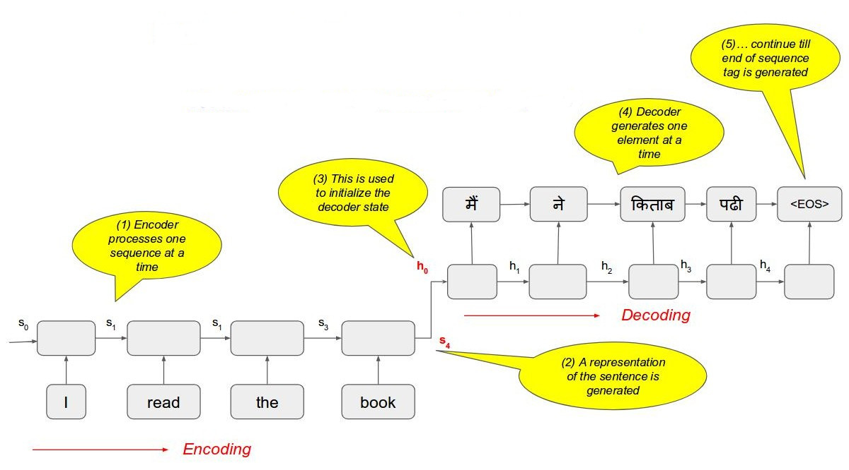
Simple RNN-based Encoder-Decoder [9] architecture overview
s₄ is the summary vector
Image source - [http://www.iitp.ac.in/~shad.pcs15/data/nmt-rudra.pdf]

Slide 127

Summary vector representation
Image source- [9]

Slide 128
Problems with simple Encode-Decode paradigm (1/2)
What happens in enc-dec architecture-
Encoding transforms the entire sentence into a single vector.
Decoding process uses this sentence representation for predicting the output.
Problems-
Quality of prediction depends upon the quality of sentence embeddings.
After few time-step, summary vector may lose information of initial words of input sentence.

Slide 129
Problems with simple Encode-Decode paradigm (2/2)
Possible solutions-
For prediction at each time step, present the representation of the relevant part of the source sentence only.
the girl goes to school
लड़की स्कूल जाती है
Attention-based encoder-decoder

Slide 130

Annotation vectors and context vectors
Context vector
c₁
Attention weights
Attention weights are calculated from alignment scores which are output of another feed-forward NN which is trained jointly.
a₁₁
a₁₂
a₁₃
a₁₄
Annotation vectors

Slide 131

Attention-based Encoder-Decoder [10] architecture
Image source- [http://www.iitp.ac.in/~shad.pcs15/data/nmt-rudra.pdf]

Slide 132

Attention-based Encoder-Decoder [10] architecture
Image source- [http://www.iitp.ac.in/~shad.pcs15/data/nmt-rudra.pdf]

Slide 133

Attention-based Encoder-Decoder [10] architecture
Image source- [http://www.iitp.ac.in/~shad.pcs15/data/nmt-rudra.pdf]

Slide 134

Transformer [11]
Motivations to choose Transformer over RNN-
Faster
More efficient.
Architecture-
This is an encoder-decoder architecture with Transformers instead of RNNs.
I am a student
मैं एक छात्र हूँ
Image source: [jalammar.github.io/illustrated-transformer/]

Slide 135

Transformer: Embedding
Embedding-
Input of the encoder = sum(word_embedding, positional encoding)
To set a constant and small vector_size of positional encoding, researchers apply a strategy using sinusoidal function for which model can translate long sentences of the training set.
सोच मशीन <EOS>
Image source: [jalammar.github.io/illustrated-transformer/]

Slide 136

Transformer: Encoder
Self attention-
For each input token X, self attention mechanism generates an output vector Z of same size.
Multi-head attention-
Input vectors are processed for multiple sets (heads) to get an output for each set.
Outputs are combined and processed then to get final encoder output Z.
Add and normalise - LayerNorm(X+Z)
Feedforward
Add and normalise
Image source: [jalammar.github.io/illustrated-transformer/]

Slide 137

Transformer: Multi-head attention
Multiply the input X (or output R of last encoder) with trainable W_{i}^{Q}, W_{i}^{K}, W_{i}^{V} to get Q_{i}, K_{i}, V_{i}, for each head i . (8 number of heads used).
Prepare Z_{i} of X for i-th head as ∑softmax((Q.K^{T})/√d)V^{x}, where d is size of Q.
Z_{i} to Z conversion → concatenate then multiply with trainable Wº to transform into a vector Z matching size of X.
or previous encoder output
Q: Query; K: Key; V: Value.
Image source: [jalammar.github.io/illustrated-transformer/]

Slide 138

Transformer: Enc-Dec attention
Output seq
Same as self-attention, except–
It takes the K and V from the output of the encoder stack and creates its Q from the layer below it.
Input seq
Output seq at (t-1)
Image source: [https://towardsdatascience.com]

Slide 139
Transformer: Decoder
Self-attention: In decoder side the self-attention layer is only allowed to attend to earlier positions in the output sequence. This is done by masking future positions.
Add and normalize
Encoder-decoder attention
Add and normalize
Feedforward
Add and normalize
सोच मशीन <EOS>
सोच मशीन
Image source: [jalammar.github.io/illustrated-transformer/]

Slide 140

Transformer: Entire scenario
Image source: [11]

Slide 141
Some BLEU scores for Indian Language NMT
Language pair (src\tgt) | Hi | Pa | Bn | Gu | Mr
Hi | - | 60.77 | 28.75 | 52.17 | 31.66
Pa | 64.67 | - | 25.32 | 44.74 | 27.78
Bn | 31.79 | 26.96 | - | 24.82 | 16.61
Gu | 55.02 | 46.48 | 25.33 | - | 25.62
Mr | 42.97 | 37.08 | 21.82 | 33.29 | -
Source: [Dewangan, Shubham, et al. "Experience of neural machine translation between Indian languages." Machine Translation 35.1 (2021): 71-99.]

Slide 142
Summary
Machine translation is a hard problem because of language divergence.
BLEU is an automatic evaluation metric to measure the quality of MT output.
RBMT, EBMT, SMT, and NMT are 4 paradigms of MT.
From RBMT to NMT, need for human effort decreases with the cost of data availability.
We discussed RNN-based and Transformer-based encoder-decoder architectures.

Slide 143
LaBSE Filtering

Slide 144
Introduction
Techniques to extract good quality parallel data from the Hindi-Marathi Samanantar Corpus to improve the quality of our Hindi-Marathi MT models.

Slide 145
Motivation
Neural Machine Translation (NMT) models are “data hungry”.
The comparable corpora have increased tremendously on the World Wide Web, making it an important source for MT task.
The mined sentence pairs are high in quantity but their quality varies a lot. This affects the quality of the MT systems.
Hence, there is a need to come up with a preprocessing step to extract only the good quality sentence pairs from the comparable and parallel corpora before passing them to the MT model.

Slide 146
Literature
Techniques :
LaBSE
Distilled PML

Slide 147
LaBSE
by Google AI
Language agnostic BERT sentence embedding model is based on a multilingual BERT model.
Supports 109 languages including some Indic-languages.

Slide 148

LaBSE
What is Multilingual Embedding Model?
that maps text from multiple languages to a shared vector space.
Means similar words will be closer and unrelated words will be distant in the vector space as shown in fig:
Image source- Language agnostic Bert Sentence Embedding [1]

Slide 149

Model Architecture
The model architecture is based on Bi-Directional dual encoder with an additive margin loss.
Image source- Language agnostic Bert Sentence Embedding [1]

Slide 150
LaBSE Training PIPELINE
Firstly multilingual BERT model is trained on 109 languages for MLM (Masked Language Modelling) task.
The obtained BERT encoders is used in parallel at source and target for fine-tuning the Translation Ranking Task.

Slide 151

What is Softmax Loss?
Confusion? Softmax activation and Softmax loss are different?
It is a softmax activation followed a Cross-Entropy loss
It is used for multiclass classification.
Also known as Categorical Cross-Entropy loss.

Slide 152

Additive Margin Softmax loss
Motivation :
In a classification task, we face a problem when output lies near the decision boundary in the vector space.
AM-Softmax aims to solve this by adding a margin to the decision boundary in order to increase the separability of the classes and also making the intra-class distance more compact.
Image source- LaBSE [1]

Slide 153
Literature
Techniques :
LaBSE
Distilled PML

Slide 154
Distilled PML
Distilled Paraphrase Multilingual Model is a Sentence BERT (SBERT) model extended to multiple languages using multilingual knowledge distillation.
Knowledge Distillation : Compressing a model by teaching a smaller network exactly what to do at each step using an already bigger trained model.
A Teacher-Student Model Architecture is use to train Distilled PML model.

Slide 155

Model Architecture
Given parallel data (e.g. English and German), train the student model such that the produced vectors for the English and German sentences are close to the teacher English sentence vector.
Image source- Making Monolingual Sentence Embedding Multilingual using Knowledge Distillation [2]

Slide 156
Model Training
The English SBERT model is chosen as a teacher model.
XLM-RoBERTa (XLM-R) model is chosen as a student model.
So in short student model is trained using XLM-R and further fined tuned on English NLI (Natural language Inference) and STS (Semantic Text Similarity) task using English SBERT model.

Slide 157
Dataset Used (1/3)
Samanantar Corpus
It is the biggest parallel corpus publically available for Indic languages. In our experiments we used Hindi-Marathi Samantar corpus
Dataset | # of Parallel Sentences
Samanantar Corpus | 19L

Slide 158
Dataset Used (2/3)
Combined Corpus:
Dataset | # of Parallel Sentences
PIB | 1,08,063
PMI | 29,973
Tatoeba | 46,277
ILCI | 4,62,777
Total Combined Corpus | 6,07,832

Slide 159
Dataset Used (3/3)
Test Datasets:
Corpus Name | # of Test Sentences
WAT21 | 2390
ILCI | 2000

Slide 160
Approach
LaBSE model is used to generate the sentence embeddings of the Hindi-Marathi Samanantar Corpus.
These embeddings are used to compute the cosine similarity between the Hindi-Marathi sentence pairs.
Based on these similarity scores we extract the good quality sentence pairs using a threshold similarity score.
Then we use these good quality sentence pairs to train the Hindi-Marathi MT systems.

Slide 161
Implementation
Experiments:
Baseline
Without LaBSE Filtering
LaBSE

Slide 162
Baseline
We use only the combined corpus to train the Hindi-Marathi Baseline models.
The combined corpus consists of 6L sentences. The train and tune split given below
Corpus | #Train | #Tune
Combined Corpus + Tatoeba (ILCI + PMI + PIB +Bible +Tatoeba) | 6,07,832 | 14,390

Slide 163
Without LaBSE Filtering
In this experiment we trained another Hindi-Marathi MT model using the Combined Corpus and whole Samanantar Corpus
The train and tune split is shown below:
Corpus | # Train | # Tune
Combined Corpus + Tatoeba (ILCI + PMI + PIB +Bible +Tatoeba) | 6,07,832 | 14,390
Samanantar | 19,72,689 | -
Total | 25,80,677 | 14,390

Slide 164
LaBSE based Filtering
Hindi-Marathi MT model is trained using the Combined Corpus and LaBSE filtered Samanantar Corpus.
We use the LaBSE model provided by the huggingface to generate the LaBSE scores for the whole Samanantar Corpus.
We also computed the LaBSE scores on the PMI corpus, which is a good quality Hindi-Marathi parallel corpus.
We computed the average LaBSE score which turned out to be 0.89. So we chose 0.9 as the threshold LaBSE score.
LaBSE model provided by the huggingface :
https://huggingface.co/sentence-transformers/LaBSE

Slide 165
Samanantar LaBSE Data Analysis
LaBSE score Range | No. of Parallel Sentences
>=0.9 | 3,54,315
>=0.91 | 2,89,802
>=0.92 | 2,32,187
>=0.93 | 1,80,776
>=0.94 | 1,36,200
>=0.95 | 97,860
>=0.96 | 65,167
>=0.97 | 38,699
>=0.98 | 17,796
>=0.99 | 4,103

Slide 166
LaBSE based Filtering
We extracted 3.5L sentences from Samanantar Corpus that had a LaBSE score of 0.9 and above.
The train, tune split for this model is given below
Corpus | #Train | #Tune + Test
Combined Corpus + Tatoeba (ILCI + PMI + PIB +Bible +Tatoeba) | 6,07,832 | 14,390
Samanantar_labse (labse>=0.9) | 3,54,314 | -
Total | 9,62,146 | 14,390

Slide 167
Implementation (1/2)
Training
We have used transformer architecture for all our models.
We trained the NMT model with the help of OpenNMT-py library
OpenNMT-py is an open source Toolkit https://github.com/OpenNMT/OpenNMT-py

Slide 168
Implementation (2/2)
Training
The parameters for the transformer model are shown below
Encoder Type | Transformer
Decoder Type | Transformer
Number of layers in encoder/decoder | 6
Number of attention heads | 8
Size of encoder embedding dimensions | 512
Dropout | 0.1

Slide 169
Results (1/5)
Hindi-Marathi MT model
Models | BLEU Score
 | WAT21 | ILCI
Baseline | 13.8 | 33.2
Without LaBSE filtering | 16.9 | 33.0
LaBSE filtering | 17.8 | 33.2
We used sacrebleu python library to calculate the BLEU scores.
https://github.com/mjpost/sacrebleu

Slide 170
Results (2/5)
Hindi-Marathi MT Model
We see an increment of 4 BLEU score points in LaBSE filtered model as compared to Baseline on WAT21 test data.
Increment of 1 BLEU score points as compared to the “without LaBSE filtered model” on WAT21 test data.
We also see that the BLEU score on ILCI dataset remains the same for Baseline and LaBSE filtered model, while it decreases by 0.2 points for “without LaBSE filtered model”.

Slide 171
Results (3/5)
Marathi-Hindi MT model
Models | BLEU Score
 | WAT21 | ILCI
Baseline | 22.1 | 37.4
Without LaBSE filtering | 21.6 | 33.6
LaBSE filtering | 25.1 | 37.9

Slide 172
Results (4/5)
Marathi-Hindi MT Model
Increment of 3 BLEU score points in LaBSE filtered model as compared to Baseline on WAT21 test data.
Increment of 4 BLEU score points as compared to “without LaBSE filtered model” on WAT21 test data.
We also see that the BLEU score on ILCI dataset, increments by 0.5 for LaBSE filtered model as compared to Baseline, while it decreases by 4 points for “without LaBSE filtered model”.
This is because the Samanantar corpus doesn’t consist of the in-domain data of ILCI dataset.

Slide 173

Results (5/5)
We also computed the Spearman’s rank correlation coefficient between LaBSE and Distilled PML scores.
These scores were computed on a set of 5000 Hindi-Marathi parallel sentences.
The correlation coefficient turned out to be 0.38
Scatter plot of LaBSE and Distilled PML scores

Slide 174
Summary
Neural Machine Translation systems are “data-hungry”.
But the quality of the parallel data is as important as the quantity.
We presented an approach to extract good quality parallel data from the Samanantar Corpus using the LaBSE score to improve the Hi-Mr MT systems.
This helped us defeat the Baseline Hi-Mr MT systems.

Slide 175
References
[1] Fangxiaoyu Feng and Yinfei Yang and Daniel Cer and Naveen Arivazhagan and Wei Wang. 2020. Language-agnostic BERT Sentence Embedding.
[2] Reimers, Nils and Gurevych, Iryna. 2020. Making Monolingual Sentence Embeddings Multilingual using Knowledge Distillation.

Slide 176
Latest Developments

Slide 177
Phrase Table Injection (1/3)
In this technique, phrase table is extracted from the Source-Target parallel corpus.
Finally the Source-Target NMT model is trained using the Source-Target Parallel Corpus and Source-Target Phrases.

Slide 178

Phrase Table Injection (2/3)

Slide 179
Phrase Table Injection (3/3)
Dataset
Results
 | Train | Test (WAT 2021)
Number of Sentences | 250,347 | 2390
 | BLEU Score
Baseline | 16.26
Phrase Table Injection | 17.15
[12]

Slide 180
Pivoting
Pivoting means utilizing the resources of a related high-resource language for the task of translation between language pairs involving low resource language.
Example:
Utilizing the resources of Hindi for the task of translation between English-Marathi.
Utilize the resources of English for the task of translation between Hindi-Marathi or distant language pairs like Russian-Marathi.

Slide 181

Pivoting: Cascade Models
Cascade Model

Slide 182
Pivoting: Cascade Models
Advantages
Translation between language pairs that don’t have sufficient parallel corpus, but each of those language has sufficient parallel corpus with pivot language (for example English).

Slide 183
Pivoting: Cascade Models
Disadvantages
Double Decoding Time
As the source sentence is passed through two NMT models the decoding time is doubled.
Propagating Errors
As the source sentence is passed through two NMT models, each model introduces its own errors in translation.

Slide 184
Pivoting: Combined Corpus Model
In this technique, first the Source-Target and Source-Pivot parallel corpus are combined and a NMT model is trained on this combined data.
This model is then used as an initialization and the final Source-Target NMT model is trained by finetuning on the Source-Target Parallel corpus.

Slide 185

Pivoting: Combined Corpus Model

Slide 186
Pivoting: Combined Corpus Model
Initially training the model on combined (En-Hi, En-Mr) the model learned some representation and knowledge from the pivot language data (En-Hi).
This representation and knowledge can be useful for the final task of En-Mr translation.

Slide 187
Pivoting: Combined Corpus Model
Dataset
Results
 | Train | Test (WAT 2021)
Number of Sentences | 250,347 | 2390
 | BLEU Score
Baseline | 16.26
Combined Corpus | 18.02
[12]

Slide 188
Pivoting: Direct Pivoting Model
In Direct Pivoting technique we initially train 2 models: source-to-pivot and pivot-to-target.
Then we initialize the encoder and decoder of the source-to-target model using the encoder of source-to-pivot model and decoder of pivot-to-target model.
Then we finetune the source-to-target model on source-target parallel data.

Slide 189

Pivoting: Direct Pivoting Model
[13]

Slide 190
Pivoting: Direct Pivoting Model
Dataset
Results
 | Train | Test (WAT 2021)
Number of Sentences | 250,347 | 2390
 | BLEU Score
Baseline | 16.26
Direct Pivoting | 16.68
[12]

Slide 191
Multilingual NMT
Motivation
Translation between N languages to N languages will require O(N^2) models.
A single N-to-N multilingual model can translate between all O(N^2) language directions.
Multilingual Models share knowledge between all languages improving performance for low resource language pairs.

Slide 192

Multilingual NMT
Parameter sharing: Shared encoder and decoder
Need to find the right amount of shared parameters
Johnson, Melvin, Mike Schuster, Quoc V. Le, Maxim Krikun, Yonghui Wu, Zhifeng Chen, Nikhil Thorat et al. "Google’s multilingual neural machine translation system: Enabling zero-shot translation." Transactions of the Association for Computational Linguistics 5 (2017): 339-351.

Slide 193


Google’s MNMT System (Johnson et al., 2017)
A single multilingual model

Slide 194

Massively Multilingual Neural Machine Translation
Trained Multilingual model on 59 languages. (Aharoni et al., 2019)

Slide 195
Unsupervised MT

Slide 196
Unsupervised MT
No parallel corpus
Train using only monolingual data
However, the requirement is:
Large monolingual corpus
Cross-lingual Word Embeddings

Slide 197

Cross-lingual Word Embeddings
The geometric relations that hold between words are similar across languages.
For instance, numbers and animals in English show a similar (isomorphic) geometric structure as their Spanish counterparts.
The vector space of a source languages can be transformed to the vector space of the target language t by learning a linear projection with a transformation matrix W_{s→t.}
Image source- www.mikelartetxe.com

Slide 198
Autoencoder
Input layer
Output layer
Representation learning
Neural network to learn reconstruction of the data
Optimize Reconstruction Error
Balance between
Accurately build a reconstruction
Handle inputs such that the model doesn’t learn to copy the data
x₁
x₁
Hidden layer
x₂
h₁
x₂
x₃
h₂
x₃
x₄
h₃
x₄
x₅
x₅

Slide 199
Denoising auto-encoder
Learn to generate original sentence from a noisy version of it
Eliminates the learning of identity function
x₁
nx₁
x₁
x₂
nx₂
h₁
x₂
x₃
nx₃
h₂
x₃
x₄
nx₄
h₃
x₄
x₅
nx₅
x₅
Corrupted data

Slide 200
Denoising auto-encoder
Noisy sentence
Encoder representation is the representation for noisy sentence
Decoder tries to generate the original sentence from the encoder representation of the noisy sentence
A sentence can be corrupted using different types of noise
Swapping of words
Removal of words
Replacement of words with other words
Encoder
Decoder
Original sentence

Slide 201
Back-Translation
Utilize monolingual data of target language
Generate pseudo parallel data using MT system in opposite direction (target->source)
Generation of pseudo parallel sentences
Monolingual data of L2
MT system (L2>-L1)
Translated sentences
Train MT system (L1->L2) using a combination of parallel and generated synthetic data both
Sennrich, Rico, Barry Haddow, and Alexandra Birch. "Improving Neural Machine Translation Models with Monolingual Data." In Proceedings of the 54th Annual Meeting of the Association for Computational Linguistics (Volume 1: Long Papers), pp. 86-96. 2016.

Slide 202
Iterative Back-Translation
D=Parallel corpus
SD=Synthetic data
Train MT_{L2->L1} using D
D = D U SD
Generate synthetic data(SD) for MT_{L1->L2} using MT_{L2->L1}
Generate synthetic data(SD) for MT_{L2->L1} using MT_{L1->L2}
D = D U SD
Train MT_{L1->L2} using D

Slide 203

Iterative Back-Translation
Beneficial for Low resource languages
Hoang, Vu Cong Duy, Philipp Koehn, Gholamreza Haffari, and Trevor Cohn. "Iterative back-translation for neural machine translation." In Proceedings of the 2nd Workshop on Neural Machine Translation and Generation, pp. 18-24. 2018.

Slide 204
Language model pretraining for Unsupervised NMT

Slide 205
General Framework
L1 Monolingual Corpus
Language Model Pre-Training
L2 Monolingual Corpus
Unsupervised NMT Fine Tuning
Pre-Training
Fine-Tuning

Slide 206
mBERT (Devlin et al., 2019)
Unsupervised pre-training
Transfer learning with language models
MLM (Masked language modeling objective) + Next sentence prediction
Fine-tuned for language understanding and question answering tasks
Kenton, Jacob Devlin Ming-Wei Chang, and Lee Kristina Toutanova. "Bert: Pre-training of deep bidirectional transformers for language understanding." In Proceedings of NAACL-HLT, pp. 4171-4186. 2019.

Slide 207
MuRIL (Khanuja et al., 2021)
Multilingual LM for Indic languages (16 indic languages and english).
Transliterated data (Native → Latin)
MLM (Masked language modeling) + TLM (Translation language modeling) objective
Fine-tuned for language understanding and question answering tasks
Khanuja, Simran, Diksha Bansal, Sarvesh Mehtani, Savya Khosla, Atreyee Dey, Balaji Gopalan, Dilip Kumar Margam et al. "Muril: Multilingual representations for indian languages." arXiv preprint arXiv:2103.10730 (2021).

Slide 208

XLM Pre-Training (Conneau et al.,2019)
Conneau, Alexis, and Guillaume Lample. "Cross-lingual language model pretraining." Advances in Neural Information Processing Systems 32 (2019): 7059-7069.zy

Slide 209
XLM Fine Tuning
Perform fine-tuning using
Iterative back-translation
Denoising auto-encoding
Alternate between the two objective
Denoising auto-encoding helps in better training of the decoder

Slide 210

MASS Pre-Training (Song et al., 2019)
MASS: Masked Sequence to Sequence Pre-training for Language Generation, ICML, Song et.al 2019
Perform fine-tuning using : Iterative back-translation
Song, Kaitao, Xu Tan, Tao Qin, Jianfeng Lu, and Tie-Yan Liu. "MASS: Masked Sequence to Sequence Pre-training for Language Generation." In International Conference on Machine Learning, pp. 5926-5936. PMLR, 2019.

Slide 211
For each batch
BART Pretraining
I go __ __ daily
⬇ ⬇ ⬇ ⬇ ⬇
Trained by
Corrupting text with an arbitrary noising function
Learning a model to reconstruct the original text.
Denoising full text
Multi-sentence level
Bi-directional Encoder
Randomly select from {src,tgt}
Attention
<s>
I
go
to
school
➡
➡
➡
➡
➡
I
go
to
school
daily
➡
➡
➡
➡
➡
D
e
c
o
d
e
r
Lewis, Mike, Yinhan Liu, Naman Goyal, Marjan Ghazvininejad, Abdelrahman Mohamed, Omer Levy, Ves Stoyanov, and Luke Zettlemoyer. "BART: Denoising Sequence-to-Sequence Pre-training for Natural Language Generation, Translation, and Comprehension." Proceedings of the 58th Annual Meeting of the Association for Computational Linguistics, (ACL 2020)

Slide 212
BART pretraining (possible noising steps) (Lewis et al. 2020)
Token Masking
My _ is John. I __ school daily.
Token deletion
My name John. I go to daily.
My name is John. I go to school daily.
Text infilling
My _ John. I go _.
Original document
Sentence permutation
I go to school daily. My name is John
Document rotation
name is John. I go to school daily. my

Slide 213
mBART (Liu et al 2020)
A sequence-to-sequence denoising auto-encoder pre-trained on large-scale monolingual corpora in many languages using the BART objective
Unsupervised NMT
BART pretraining using monolingual corpora of multiple languages + Iterative Back-Translation
Yinhan Liu, Jiatao Gu, Naman Goyal, Xian Li, Sergey Edunov, Marjan Ghazvininejad, Mike Lewis, and Luke Zettlemoyer. Multilingual denoising pre-training for neural machine translation. arXiv2020.

Slide 214

mBART (Liu et al 2020)
Pre-training using BART objective on multiple languages
En-De and En-ro are only trained using specified source and target languages
En-Ne and En-Si, the pretraining is performed using mBART on 25 languages.
mBART also generalizes well for the languages not seen in pretraining.
Results: mBART (only on source and target language) pretraining for unsupervised NMT
Yinhan Liu, Jiatao Gu, Naman Goyal, Xian Li, Sergey Edunov, Marjan Ghazvininejad, Mike Lewis, and Luke Zettlemoyer. Multilingual denoising pre-training for neural machine translation. arXiv preprint arXiv:2001.08210, 2020.

Slide 215
Unsupervised NMT for Indic Languages

Slide 216
Motivation
Unsupervised NMT for Indic languages
There is lot of cognate overlap between some of the Indic language pairs
Baseline UNMT (MASS pretraining + Iterative back-translation)
low performance for language-pairs with low lexical overlap.

Slide 217


Data
Monolingual data: AI4Bharat¹
Test and validation data: Combination of ILCI² and WAT 2020 multi-indic-mt³ task data (only common sentences are fetched to create validation and test data for indic-indic language pairs)
¹ https://indicnlp.ai4bharat.org/corpora/
² Jha, Girish Nath. "The TDIL program and the Indian language corpora initiative." In Language Resources and Evaluation Conference. 2012.
³ http://lotus.kuee.kyoto-u.ac.jp/WAT/indic-multilingual/

Slide 218
Approaches
The lexical divergence between source and target languages play a big role in the success of UNMT.
We explore following approaches
Baseline unsupervised NMT (MASS pretraining + iterative back-translation)
Script conversion (Transliteration to a common script)
Unsupervised bilingual embedding based initialization to bring the vocabulary of the two languages closer
Dictionary word substitution using a bilingual dictionary.
Randomly replace whole words in the sentence with the corresponding word translation obtained from a ground truth bilingual dictionary as a preprocessing step

Slide 219

Results: Language-pairs with High Lexical Overlap

Slide 220

Results: Language-pairs with Low Lexical Overlap

Slide 221

Lexical Similarity versus BLEU score
The correlation between lexical similarity between source and reference sentences and BLEU score for Gujarati →Hindi.

Slide 222

Lexical Similarity versus BLEU score
The correlation between lexical similarity between source and reference sentences and BLEU score for Hindi → Malayalam.
r value with original script is very low.

Slide 223

Shared Vocabulary

Slide 224

Qualitative Analysis
Fluent but inadequate translations

Slide 225

Qualitative Analysis
Meaning drift due to transliteration
চলুন (Chaluna) → to go, মেন চলুন (mene chaluna) →maintain
The Hindi translation for the verb chaluna is चलो (chalo). [This happens because of transliteration and bilingual embeddings]

Slide 226
Summary
Current state of the art approaches in unsupervised NMT
Analysis of Unsupervised NMT for Indic languages
The lexical divergence between source and target language plays an important role.
3 approaches to bridge lexical divergence between source and target languages
Script conversion
Initialization using bilingual embeddings
Dictionary word substitution

Slide 227
Machine Translation
Demonstration

Slide 228
Automatic Post Editing

Slide 229
Outline
Motivation
Problem Statement
Challenges
Categorization of APE Systems
APE Paradigms
WMT APE Shared Tasks
HW-TSC’s APE System
Experiments and Results

Slide 230
Motivation
Machine Translation (MT) systems : far from perfect
Requirement of post-processing through human intervention
Generation of parallel data (mt_op <--> post-edited mt_op)
Can we automate the post-processing phase using this data?
Use cases:
Ideal: to eliminate the need of human involvement.
Black-box scenario: To further improve translations by identifying and correcting recurring MT errors
Adapt terminologies for a specific domain

Slide 231
Problem Statement
Automatic Post Editing (APE) : Given the translations generated by a machine translation system, generate corrected versions of them which are publishable.
The edits should be minimal.
In a supervised setting, training data contains triplets:
Source sentence: People can get COVID-19 even after vaccination.
MT translation: लसीकरणानंतरही लोकांना कोविड - 19 मिळू शकतो .
Human post-edited version: लसीकरणानंतरही लोकांना कोविड - 19 होऊ शकतो .
Input: MT translation, Output: Human post-edited version

Slide 232
Categorization of APE systems
APE Systems can be categorized as follows:
Accessibility of MT System: Black-box or Glass-box
Type of Post-editing Data: Real or Synthetic
Domain of the Data: General or Specific
We focus on:
Black-box scenario
Real as well as Synthetic Data
Domain Specific APE systems

Slide 233
Challenges (1/2)
Data :
Deep Learning based Methods: data-hungry
Data Sparsity
Increased complexity: Same error can be corrected in more than one way
Coverage of error-correction patterns
Requirement of new datasets

Slide 234
Challenges (2/2)
Technology :
Neural APE systems: Follow similar trend as MT
Joint modelling of SRC and MT_OP helps, but increases data sparsity
Poses a risk of unnecessary edits
Issue of overfitting
Requirement: Techniques resilient to problem of over-correction, and can work in low-resource settings

Slide 235
APE Paradigms (1/2)
APE task: a monolingual translation task
The same MT technology has been used for APE
Rule-based APE:
Not much work done
Uses precise PE rules
The rules might not be capturing all possible scenarios
Not portable across domains

Slide 236
APE Paradigms (2/2)
Phrase-based APE:
Dominated the APE field for a few years
Showed significant improvements when underlying MT system was rule-based
Limited improvements when underlying MT system was SMT
Neural APE:
Current-state-of-the-art
Showed significant improvements when underlying MT system is SMT

Slide 237
Terminologies
SRC: source language sentence
MT_OP: translation of SRC generated using a MT system
MT_REF: reference target language sentence for the SRC
PE_REF: Human post-edited version of MT_OP
PE_OP: Output generated by the APE system
Triplet: (SRC, MT_OP, PE_REF)
Example:
SRC: People can get COVID-19 even after vaccination.
MT_OP: लसीकरणानंतरही लोकांना कोविड - 19 मिळू शकतो .
PE_REF: लसीकरणानंतरही लोकांना कोविड - 19 होऊ शकतो .

Slide 238
WMT APE Shared Tasks

Slide 239
WMT APE Shared Task
WMT APE Shared Task is hosted every year since 2015
Considers the black-box scenario
APE data is shared across participants
Train, development data: (SRC, MT_OP, PE_REF)
Test data: (SRC, MT_OP)
Participants submit PE_OP for the test set
The submitted systems are evaluated over the benchmark datasets
Evaluation metrics used for rankings
TER and BLEU

Slide 240
WMT APE Shared Task
Baseline APE systems:
“do nothing” APE system
Does not make any modification to MT_OP,
i.e. PE_OP = MT_OP
Participants are allowed to use any external data.
Optional resources - Synthetic corpora:
Artificial Corpus (4 Million triplets) [6]
eSCAPE corpus (14.4 Million triplet) [7]

Slide 241
WMT15 APE Shared Task
Pilot round
Language pair: English - Spanish
Domain: News
Data: Train (12,000), Development (1,000), Test(2,000) triplets
PE_REF was collected through crowd-sourcing
Number of submissions: 7
All the submissions were based on phrase-based technology
None of the submissions beat the baseline

Slide 242

WMT15 APE Shared Task
Results:
Difference between
the baseline and top ranked system: -0.315 TER points
the phrase based APE and top ranked system: 0.926
It was hypothesized that the poor results are due to origin, quantity and domain of the data.
Image Source: [1]

Slide 243
WMT16 APE Shared Task
Language pair: English - German
Domain: IT domain
Data: Train (12,000), Development (1,000), Test(2,000) triplets
PE_REF was collected through professional post-editors
Number of submissions: 11
Except two, rest of the submissions were based on phrase-based technology
7 teams crossed the baseline.
The top ranked system used
RNN based encoder-decoder model with attention
Artificially generated Data of around 4 million triplets (Using Back Translation)

Slide 244

WMT16 APE Shared Task
Results:
Difference between
the baseline and top ranked system: 3.24 TER points
the phrase based APE and top ranked system: 3.12
Have the results improved due to change of data or due to technology shift?
Image Source: [1]

Slide 245
WMT17 APE Shared Task
Language pairs and domain:
English - German (IT)
German - English (Medical)
Data for English-German: Train (11,000), Test(2,000) triplets
Data for German-English: Train(25,000), Dev(1,000), Test(2,000)
Number of submissions: 15 (English-German), 5(German-English)
Most of the submissions were based on neural approaches, and beat the baseline except one system.
The top ranked system followed neural APE approach:
Used multi-source APE System
Trained the system over synthetic corpus and fine-tuned on the provided in-domain data

Slide 246

WMT17 APE Shared Task
Results (English-German):
Difference between
the baseline and top ranked system: 4.88 TER points
the phrase based APE and top ranked system: 5.09 TER points
Image Source: [2]

Slide 247

WMT17 APE Shared Task
Results (German-English):
Difference between
the baseline and top ranked system: 0.26 TER points
the phrase based APE and top ranked system: 0.45 TER points
Difference between the baseline and phrase based APE can be seen as an indicator of task difficulty level.
Image Source: [2]

Slide 248
WMT18 APE Shared Task
Language pairs and domain: English - German (IT)
Two different MT systems: PBMT, NMT
Data for PBMT: datasets released in earlier rounds
Data for NMT: Train (13,442), Dev (1,000), Test (1,023)
Number of submissions: 11 (PBMT), 10 (NMT)
All the submissions were based on neural approaches
This allowed to compare the effectiveness of neural APE systems
The top ranked system:
Used multi-source APE System and transformer architecture
Trained the system over large synthetic corpus and fine-tuned on the provided in-domain data

Slide 249

WMT18 APE Shared Task
Results (PBMT):
Difference between the baseline and top ranked system: 6.24 TER points
Image Source: [3]

Slide 250

WMT18 APE Shared Task
Results (NMT):
Difference between the baseline and top ranked system: 0.38 TER points
Image Source: [3]

Slide 251
WMT18 APE Shared Task
Findings:
The difficulty of the APE task: proportional to quality of machine translation system.
It is easier to improve translations generated from a PBMT system, using neural APE. But, this is not the case when underlying MT is the NMT system.
Systems used the eSCAPE and Artificial corpora. The good improvements in results can be attributed to use of huge amount of synthetic data, along with the technology developments.

Slide 252
WMT19 APE Shared Task
Language pairs and domain: English-German, English-Russian (IT)
Underlying MT system: Neural
Data for English-German: datasets released in earlier rounds
Data for English-Russian: Train (15,089), Dev (1,000), Test (1,023)
Number of submissions: 18 (English-German), 4 (English-Russian)
The quality of English-Russian MT system was much higher: 76.20 BLEU score. None of the systems beat the baseline.
The top ranked system in the English-german task:
Explored transfer learning: Adapted BERT-based encoder-decoder model to APE
Used the shared encoder

Slide 253

WMT19 APE Shared Task
Results (English-German):
Difference between
the baseline and top ranked system: 0.78 TER points
Image Source: [4]

Slide 254

WMT19 APE Shared Task
Results (English-Russian):
Difference between
the baseline and top ranked system: -0.43 TER points
Image Source: [4]

Slide 255
WMT19 APE Shared Task
Findings:
The same test as previous year was used for the English-German subtask. Four systems were able to beat the top system of the last year.
The quality of translations provided for the English-Russian task was very high. Also, around 60% of the sentences required no edit. This made the problem more challenging.
This highlights the problem of over-corrections.

Slide 256
WMT20 APE Shared Task
Language pairs and domain: English-German, English-Chinese (Wikipedia)
Data sizes: Train (7,000), Dev (1,000), Test (1,000)
Number of submissions: 11 (English-German), 4 (English-Chinese)
Tradeoff: general domain vs lower quality translations
The top ranked system:
Followed the architecture of the last year’s winning team
Instead of using models like BERT, pretrained a NMT model
Used bottleneck adapter layers to prevent overfitting
Used external MT candidates. So, the input to APE looked like (SRC, MT_OP, EXT_MT_OP)

Slide 257

WMT20 APE Shared Task
Results (English-German):
Difference between
the baseline and top ranked system: 11.35 TER points
Image Source: [5]

Slide 258

WMT20 APE Shared Task
Results (English-Chinese):
Difference between
the baseline and top ranked system: 12.13 TER points
Image Source: [5]

Slide 259
WMT21 APE Shared Task
Language pairs and domain: English-German, English-Chinese (Wikipedia)
Data sizes: Train (7,000), Dev (1,000), Test (1,000)
The data is re-translated and so re-post-edited to improve the quality.
Number of submissions: 4 (English-German)
Results:
ID | TER | BLEU
Netmarble_Contrastive | 17.28 | 71.55
PVIE_Contrastive | 17.74 | 70.54
PVIE_Primary | 17.85 | 70.50
Netmarble_Primary | 17.97 | 70.53
Baseline | 18.05 | 71.07

Slide 260

WMT APE Shared Tasks: Summary
ΔTER = Baseline TER - TER of the top-ranked system
Requirement of post-edits from professional post-editors
Domain of the data
Type of underlying MT system and Quality of translations
Technology Development: Utilization of more and more data
Uncertainty about effectiveness of current neural approaches

Slide 261

HW-TSC’s APE System
Winner of WMT20 APE Shared Task [8].
Used transfer learning: Fine-tuned a pre-trained NMT model on the in-domain APE data
Used data augmentation: translated the source sentences in the APE data using Google’s MT system in order to increase diversity of features.
To control the issue of over-fitting, ‘Bottleneck Adapter Layers’ are used.
It is a low-dimensional FNN layer.
Image Source: [8]

Slide 262

HW-TSC’s APE System
Data used for training NMT model: WMT19 news translation dataset for English-German, and WMT20 news translation dataset
APE Data: 7000 triplets (wikipedia domain)
Results on the development set (1000 triplets):
Image Source: [8]

Slide 263
Experiments and Results

Slide 264
Experiment 1
Goal: To compare different Neural APE approaches.
We have a English-Marathi parallel corpora but do not have corresponding human post-edits. So we generate an artificial data which can be used to train and evaluate the APE models.
APE Data Generation : We used two different methods to generate the artificial triplets (SRC, MT_OP, PE_REF) using the Legal domain data from the Anuvaad corpora.
Using MT_REF as PE_REF
Triplet: (SRC, MT_OP, MT_REF)
Using round-trip translation
Used Marathi-English MT system to translate MT_REF to SRC’
Used English-Marathi MT system to translate SRC’ to MT_OP’
New triplet is formed as (SRC’, MT_OP’, MT_REF)
Found that the translations generated using this method are noisy.
Data size: Training: 1.5 lac, Validation: 15k, Testing: 15k

Slide 265
Experiment 1
APE Systems:
Single-source:
Treats the APE task as a monolingual translation task.
Ignores the SRC. Input to the APE system is MT_OP, and produces PE_REF.
Multi-Source:
Exploits dependency of errors in translation on the source sentence and the corresponding translation.
Input to the system is a (SRC, MT_OP) pair, and outputs the PE_REF.
The method uses two separate encoders: one encodes the SRC and the other encodes the MT_OP. And then, a single decoder produces the PE_REF.

Slide 266
Experiment 1
APE Systems:
Multi-source (with shared encoder)
This setting uses a single encoder to encode both the SRC and MT_OP.
It is beneficial when both languages share the vocabulary.
SRC and MT_OP are concatenated and passed to the encoder as a single sequence.
Neural Programmer Interpreter
Instead of following an end-to-end approach that directly generates a edited sentence from the translation, the method follows a two step approach.
In the first phase, the translation is mapped to a sequence of edit operations (insert, keep, delete), and then this sequence along with the translation is used to generate a post-edited sentence.

Slide 267
Experiment 1
Note:
Training data: 1.5L triplets
No human post-edited data
Underlying NMT system is trained on multi-domain data
Used 1000 PE-REF segments to get ‘N-modified’
APE System | BLEU | TER | N-modified
Baseline (No APE) | 38.54 | 41.90 | -
Single Source | 34.86 | 45.55 | 50
Multi-source | 37.25 | 42.37 | 42
Multi-source (Shared Encoder) | 34.50 | 46.23 | 53
Neural Programmer-Interpreter | 27.22 | 53.57 | 67

Slide 268
Experiment 1
Analysis:
Not able to find any APE system-specific patterns
General observation: Unnecessary edits are performed by the APE systems.
Example (Using the Multi-source APE model)
SRC: Special powers in case of urgency.
MT_REF (and PE_REF): निकडीच्या बाबतीत विशेष अधिकार.
MT_OP: तातडीच्या बाबतीत विशेष शक्ती.
PE_OP: तातडीच्या परिस्थितीत विशेष शक्ती.

Slide 269
Experiment 2
Language Pair: English - German
Data (IT Domain):
Combined Training datasets from WMT16, 17, 18 APE shared task
Training Data: 36442 Triplets (SRC, MT_OP, PE_REF)
Test Data: 1023 Triplets (WMT18 APE Shared Task - NMT)
Synthetic Data: 1M Triplets from eSCAPE corpus
Models:
Single Source APE: trained using the synthetic data
Multi Source APE: trained using the synthetic data
Multi Source APE: trained using the synthetic data + fine-tuned on the Combined Training data

Slide 270
Experiment 2
Model | TER | BLEU
Baseline (No APE) | 16.84 | 74.73
Single-source (Synthetic) | 20.02 | 69.38
Multi-source (Synthetic) | 18.89 | 71.39
Multi-source (Fine-tuned) | 16.83 | 74.73
Neural Program-Interpreter (NPI) (Synthetic) | 19.07 | 71.10
NPI (Fine-tuned) | 18.45 | 72.82

Slide 271
Summary
From the review of WMT APE Shared, it is clear that the APE can be used in the black-box scenario to further improve quality of translations.
Recent advancements show a paradigm shift in the field of APE from statistical based APE approaches to neural approaches. This has also given a push to novel ways of synthetic data generation.
New APE techniques: utilize more and more knowledge.
Single-source -- Multi-source -- Pretrained Models -- Data Augmentation
Whether APE can be used to further improve quality of translations obtained using a high quality NMT system is still unclear.
The problem of over-correction is prominent when the underlying MT system is of high quality.

Slide 272
References
[1] Ondřej Bojar, Rajen Chatterjee, Christian Federmann, Yvette Graham, Barry Haddow, Matthias Huck, Antonio Jimeno Yepes et al. "Findings of the 2016 conference on machine translation." In Proceedings of the First Conference on Machine Translation: Volume 2, Shared Task Papers, pp. 131-198. 2016.
[2] Ondřej Bojar, Rajen Chatterjee, Christian Federmann, Yvette Graham, Barry Haddow, Shujian Huang, Matthias Huck et al. "Findings of the 2017 conference on machine translation (wmt17)." In Proceedings of the Second Conference on Machine Translation, pp. 169-214. 2017.
[3] Rajen Chatterjee, Matteo Negri, Raphael Rubino, Marco Turchi. “Findings of the WMT 2018 Shared Task on Automatic Post-Editing.” In Proceedings of the Third Conference on Machine Translation: Shared Task Papers, pp. 710-725. 2018
[4] Rajen Chatterjee, Christian Federmann, Matteo Negri, and Marco Turchi. "Findings of the WMT 2019 shared task on automatic post-editing." In Proceedings of the Fourth Conference on Machine Translation (Volume 3: Shared Task Papers, Day 2), pp. 11-28. 2019.
[5] Rajen Chatterjee, Markus Freitag, Matteo Negri, Marco Turchi. Findings of the WMT 2020 Shared Task on Automatic Post-Editing. Proceedings of the Fifth Conference on Machine Translation, EMNLP, Nov. 2020, 646-659, 2020.

Slide 273
References
[6] Junczys Dowmunt, Marcin, and Roman Grundkiewicz. "Log-linear combinations of monolingual and bilingual neural machine translation models for automatic post-editing." In Proceedings of the First Conference on Machine Translation: Volume 2, Shared Task Papers, ACL. 2016.
[7] Matteo Negri, Marco Turchi, Rajen Chatterjee, Nicola Bertoldi. “ESCAPE: a Large-scale Synthetic Corpus for Automatic Post-Editing.” In Proceedings of the Eleventh International Conference on Language Resources and Evaluation (LREC). 2018.
[8] Yang, Hao, Minghan Wang, Daimeng Wei, Hengchao Shang, Jiaxin Guo, Zongyao Li, Lizhi Lei, Ying Qin, Shimin Tao, Shiliang Sun and Yimeng Chen. “HW-TSC’s Participation at WMT 2020 Automatic Post Editing Shared Task.” WMT 2020.
[9] Sutskever, Ilya, Oriol Vinyals, and Quoc V. Le. "Sequence to sequence learning with neural networks." Advances in neural information processing systems. 2014.
[10] Bahdanau, Dzmitry, Kyung Hyun Cho, and Yoshua Bengio. "Neural machine translation by jointly learning to align and translate." 3rd International Conference on Learning Representations, ICLR 2015. 2015.
[11] Vaswani, Ashish, Noam Shazeer, Niki Parmar, Jakob Uszkoreit, Llion Jones, Aidan N. Gomez, Łukasz Kaiser, and Illia Polosukhin. "Attention is all you need." Advances in neural information processing systems. 2017.

Slide 274
References
[12] Aakash Banerjee, Aditya Jain, Shivam Mhaskar, Sourabh Dattatray Deoghare, Aman Sehgal, and Pushpak Bhattacharya. 2021. Neural machine translation in low-resource setting: a case study in English-Marathi pair. In Proceedings of Machine Translation Summit XVIII: Research Track, pages 35–47, Virtual. Association for Machine Translation in the Americas.
[13] Yunsu Kim, Petre Petrov, Pavel Petrushkov, Shahram Khadivi, and Hermann Ney. 2019a. Pivot-based transfer learning for neural machine translation between non-English languages. In Proceedings of the 2019 Conference on Empirical Methods in Natural Language Processing and the 9th International Joint Conference on Natural Language Processing (EMNLP-IJCNLP), pages 866–876, Hong Kong, China. Association for Computational Linguistics.
[14] Melvin Johnson, Mike Schuster, Quoc V. Le, Maxim Krikun, Yonghui Wu, Zhifeng Chen, Nikhil Thorat, Fernanda Viégas, Martin Wattenberg, Greg Corrado, Macduff Hughes, and Jeffrey Dean. 2017. Google’s multilingual neural machine translation system: Enabling zero-shot translation. Transactions of the Association for Computational Linguistics, 5:339–351.

Slide 275
References
[15] Roee Aharoni, Melvin Johnson, and Orhan Firat. 2019. Massively multilingual neural machine translation. In Proceedings of the 2019 Conference of the North American Chapter of the Association for Computational Linguistics: Human Language Technologies, Volume 1 (Long and Short Papers), pages 3874–3884, Minneapolis, Minnesota. Association for Computational Linguistics.

Slide 276
Speech Synthesis

Slide 277
Content
Introduction
Foundations
Production of Human Speech
Science behind Human Hearing
TTS Synthesis
Previous Approaches
Latest Developments
Demonstration

Slide 278
Content
Introduction
Foundations
Production of Human Speech
Science behind Human Hearing
TTS Synthesis
Introduction
Previous Approaches
Latest Developments
Demonstration

Slide 279

Problem Statement
My name is Shyam
Intelligible and natural sounding
In this presentation, we focus on Indian languages, specifically the Marathi language.
Also we allow the system to be non-causal, if required.

Slide 280

Motivation (1/2)
Speech synthesis has the potential to improve the daily lives of many people around the world.
It can give voice to people with speaking disabilities. E.g. People with damaged vocal tract The speech synthesiser housing of famous physicist Stephen Hawking
Img source: https://en.wikipedia.org/wiki/Speech_synthesis

Slide 281
Motivation (2/2)
Machines reading text would enable people with visual impairments or reading disabilities to comprehend any book they wish to read. E.g. Audiobooks
People who are able to understand spoken language, but cannot read text, will get a chance to gain knowledge from the books by listening them. E.g. Regions in India with high illiteracy rate.

Slide 282
Challenges
Availability of Data: The best English TTS systems are trained on 24 hours of data. The currently available data for Marathi and Hindi is 4.8 hours.
Text processing: Marathi and Hindi are almost phonemic languages. However, currently there do not exist many tools for accurate grapheme-to-phoneme conversion.
Handling words from different languages: Word sounds from other language do not have much representation in the data, making it difficult to predict.

Slide 283
Content
Introduction
Foundations
Production of Human Speech
Science behind Human Hearing
TTS Synthesis
Previous Approaches
Latest Developments
Demonstration

Slide 284

Basics of Signal Processing (1/5)
Sampling and Quantization
Storing analog signal in bits would require infinite memory
We discretize the signal along two dimensions - time and value
The discretization along the time axis is called as sampling. This requires a sampling rate to specified
The discretization along the value axis is called as quantization. This requires deciding on how many bits we want to use to store one sample of the signal.

Slide 285
Basics of Signal Processing (2/5)
Digital system
Impulse Response:
The impulse response of a system is the output that is generated when a delta signal is given as the input
It is characteristic of any digital system and provides information about how the system reacts to change in input
Output of system:
Consider a digital signal x[n], a digital system with impulse response h[n], and the output signal y[n]
Then we have, y[n] = x[n] * h[n] = ∑ x[k] h[n-k] , for all k in ( -∞, ∞ ) where, * is the convolution operator

Slide 286

Basics of Signal Processing (3/5)
Fourier Transform
Provides the frequency domain representation of any signal
Captures the relative strength of different frequencies in the signal
It is an invertible transformation
Image source: https://www.researchgate.net/figure/Fourier-transform-of-a-sum-of-sinusoids-and-filtering-the-highest-frequency_fig3_237061998

Slide 287

Basics of Signal Processing (4/5)
Discrete Fourier Transform (DFT)
Converts a digital signal input of finite length into same-length sequence which represents the samples of fourier transform of the input signal
Short-time Fourier Transform
DFT is applied to small segments of input signal
Spectrograms
The STFT of each segment of the input signal are vertically placed next to each other to form a matrix

Slide 288

Basics of Signal Processing (5/5)
Image source: https://towardsdatascience.com/understanding-audio-data-fourier-transform-fft-spectrogram-and-speech-recognition-a4072d228520

Slide 289
Source-Filter Model (1/3)
One way to model human speech is via the source-filter approach. Here, the speech is considered to formed by passing a source signal through a filter
Source: Periodic vibrations from the glottis (vocal cord)
Filter: Vocal tract, including the tongue to change its shape
Underlying Hypothesis: All sounds of any language can be produced by passing a periodic signal through some specific Linear Time-Invariant filter.

Slide 290

Source-Filter Model (2/3)
Linear Time-Invariant System
Linearity: A linear combination of any two signals as input would result in the same linear combination of corresponding outputs.
Time-invariant: Shifting the input signal along the time axis, will correspondingly shift the output signal.

Slide 291

Source-Filter Model (3/3)
Image source: https://www.vocalsonstage.com/vocals-on-stage-blog/resonance-and-articulation

Slide 292
Human Speech (1/2)
Voiced and Unvoiced
When the generation of a sound requires vibration of glottis, then we say that it is a voiced sound. Note: All vowels are voiced sounds.
When the vibration of vocal cords are not used for articulation, the generated sound is said to be unvoiced.
Plosives and Fricatives
Plosives are consonants which require a burst of air source. This is achieved via closure of mouth followed by sudden compression and burst of air (E.g. ब, प)
Fricatives are consonants which involve a constriction in the vocal tract to create aspiration (E.g. /s/ in sick, /z/ in zebra)

Slide 293

Human Speech (2/2)

Slide 294
Content
Introduction
Foundations
Production of Human Speech
Science behind Human Hearing
TTS Synthesis
Previous Approaches
Latest Developments
Demonstration

Slide 295
Perceiving Sound
Human Hearing (What makes speech sound natural?)
Loudness: Proportional to the intensity of the sound
Pitch: Human sensation of various frequencies in sound
Prosody: Refers to rhythm, stress, and intonation in sound
Absolute threshold of hearing
Minimum sound intensity of a pure tone that can be heard with no other sound in the environment
It is frequency dependent (Best range: 2kHz - 5kHz)
Measure in dB SPL, which is the pressure relative to 20 micropascal (quietest audible sound pressure level for normal hearing)

Slide 296
Logarithmic Scale and Hearing
Weber–Fechner law:
Above a minimum threshold of perception S₀, the perceived intensity P is logarithmic to the stimulus intensity S P = K log(S/S₀)
Empirical evidences support the concept that logarithmic mapping in brain minimizes relative error in perception
So, a change in intensity at a low intensity is more clearly audible compared to a change in intensity at a high intensity
Source: Varshney, Lav & Sun, John. (2013). Why do we perceive logarithmically?. Significance. 10. 10.1111/j.1740-9713.2013.00636.x.

Slide 297
Mel Frequency Cepstral Coefficient
Taking the logarithmic hearing into consideration, we can extract MFCC features from any speech signal. The components are:
Sampling and Windowing
Discrete Fourier Transform
Mel Filter Bank
Mel frequency scale: m = 2595 log₁₀(1 + f / 700)
Discrete Cosine Transform
Mel Filter Bank: Pre-decided number of triangular bandpass filters separated according to the mel frequency scale within specified minimum and maximum frequencies

Slide 298

MFCC Extraction
Image source: https://www.researchgate.net/figure/Mel-frequency-cepstrum-coefficient-MFCC-calculation_fig4_277553387

Slide 299
Content
Introduction
Foundations
Production of Human Speech
Science behind Human Hearing
TTS Synthesis
Previous Approaches
Latest Developments
Demonstration

Slide 300
History
1779 – Mechanical model was built that modelled the human vocal tract, and produced the five vowel sounds in English
1791 – Models of tongue and lips were added which allowed production of consonants along with vowels
1939 – Keyboard operated voice-synthesizer (Bell Labs)
Late 1950s – First computer-based speech-synthesis systems

Slide 301
Diphone-based Synthesis (1/3)
What is a phoneme?
The simplest, perceptually distinct units of sound in any language that clearly distinguish one word from another.
What is a diphone?
A combination of two half-phones is called as a diphone.
The core idea of diphone-based approaches is to decompose speech at the level of diphones and then combine these units based on the characters of input text.

Slide 302

Diphone-based Synthesis (2/3)
Pitch Synchronous Overlap and Add:
Speech is divided into pitch-synchronous waveforms
These are then varied in time or spectral domain to obtain synthetic versions of same speech unit
Next, the newly formed speech units are overlapped and added to generate the new speech
Ideally, there would be no information loss
Image Source: https://wiki.aalto.fi/pages/viewpage.action?pageId=155477136

Slide 303
Diphone-based Synthesis (3/3)
TD-PSOLA (Time Domain - PSOLA):
The speed and pitch of a sound is manipulated in time domain
Pitch periods are extracted from the sound signal
Pitch change: Segments are brought closer or separated
Speed change: Segments are repeated or deleted
FD-PSOLA (Frequency Domain - PSOLA):
Spectral envelope is computed using linear predictive analysis
Pitch is modified via linear interpolation to obtain synthetic versions of same sound unit
Unnatural discontinuities at concatenation boundaries

Slide 304

Unit-Selection Synthesis (1/3)
Selects & concatenates units (phonemes) from large database
Text can have additional annotations containing prosodic and phonetic context information
Database is transformed into a state transition network, with phonemes as states
The network is fully connected, since any sequence of phonemes is possible
Image source: A. J. Hunt and A. W. Black, "Unit selection in a concatenative speech synthesis system using a large speech database," 1996 IEEE International Conference on Acoustics, Speech, and Signal Processing Conference Proceedings, 1996, pp. 373-376 vol. 1, doi: 10.1109/ICASSP.1996.541110.

Slide 305
Unit-Selection Synthesis (2/3)
Cost Functions
Weighted sum of difference between target and unit feature vectors → weights for each feature need to be learned
Target cost:
Measures the difference in selected unit and target
Feature vectors: pitch, power, duration, voicing, vowel/consonant, consonant type, point of articulation
Concatenation cost:
Measures the quality of a join between selected units
Feature vectors: cepstral distance, difference in log power, pitch

Slide 306
Unit-Selection Synthesis (3/3)
Learning weights for cost functions
Weight Space Search
Regression Training
Generating final speech
Using the fully connected graph and the cost functions we can use viterbi decoding for selecting final units
The search space for viterbi decoding is pruned based on
Phonetic context
Target cost
Concatenation cost

Slide 307


WaveNet
Wavenet (Google Deepmind)
Dataset: North American English dataset (24.6 hours)
First deep neural architecture trained to generate raw audio waveforms that surpassed many approaches of the time.
Autoregressive generative model
Model consisted of dilated causal convolutional layers to increase the receptive field of CNN
Image source: Oord, Aaron van den, Dieleman, Sander, Zen, Heiga, Simonyan, Karen, Vinyals, Oriol, Graves, Alex, Kalchbrenner, Nal, Senior, Andrew and Kavukcuoglu, Koray WaveNet: A Generative Model for Raw Audio. (2016). , arxiv:1609.03499 .

Slide 308
Content
Introduction
Foundations
Production of Human Speech
Science behind Human Hearing
TTS Synthesis
Previous Approaches
Latest Developments
Demonstration

Slide 309

Framework of TTS Systems
All models described ahead follow this pattern for speech synthesis

Slide 310

Text to Mel – Tacotron 2
Tacotron2 (Google)
→ MOS: 3.86
Dataset: North American English (internal dataset)
Autoregressive model
Pre-Net module to bottleneck information flow
Post-Net module for minor corrections in generated mel spectrogram
Image source: Jonathan Shen, Ruoming Pang, Ron J Weiss, Mike Schuster, Navdeep Jaitly, Zongheng Yang,
Zhifeng Chen, Yu Zhang, Yuxuan Wang, Rj Skerrv-Ryan, et al. Natural tts synthesis by conditioning wavenet on mel spectrogram predictions. In 2018 IEEE International Conference on Acoustics, Speech and Signal Processing (ICASSP), pages 4779–4783. IEEE, 2018.

Slide 311

Perfect attention alignments

Slide 312

Text to Mel – FastSpeech
FastSpeech (Microsoft)
→ MOS: 3.84
Dataset: LJSpeech (24 hours)
Non-autoregressive model
Feed-Forward Transformer architecture (memory intensive)
Length regulator to control the length of generated phonemes.
Image source: Yi Ren, Yangjun Ruan, Xu Tan, Tao Qin, Sheng Zhao, Zhou Zhao, and Tie-Yan Liu. Fastspeech: Fast, robust and controllable text to speech. In H. Wallach, H. Larochelle, A. Beygelzimer,F. d'Alch ́e-Buc, E. Fox, and R. Garnett, editors, Advances in Neural Information Processing Systems, volume 32. Curran Associates, Inc., 2019.

Slide 313

Text to Mel – ForwardTacotron
ForwardTacotron (NVIDIA)
Dataset: LJSpeech (24 hours)
Non-autoregressive model
Tweaked FastSpeech to remove quadratic bottleneck due to self-attention
Tacotron2 purely used for phoneme duration extraction
Trained to predict energy and pitch information from ground-truth.
Image source: https://developer.nvidia.com/blog/creating-robust-neural-speech-synthesis-with-forwardtacotron/
Note: There is no paper for ForwardTacotron yet. Above details are taken from a blog released by NVIDIA

Slide 314

Vocoder – WaveGlow
WaveGlow (NVIDIA) → MOS: 4.00
Dataset: LJSpeech (24 hours)
Flow-based, non-autoregressive generative model
In flow-based networks, the function approximated by the neural network is invertible
So if z & x are the input & output respectively, then x = f₀ o f₁ o … o f_{k} (z) & z = f_{k}⁻¹ o … o f₀⁻¹ (x) where, f₁ , f₂ , …, f_{k} are the layers of the model
Image source: Ryan Prenger, Rafael Valle, and Bryan Catanzaro. Waveglow: A flow-based generative network for speech synthesis. In ICASSP 2019-2019 IEEE International Conference on Acoustics, Speech and Signal Processing (ICASSP), pages 3617–3621. IEEE, 2019

Slide 315


Generative Adversarial Networks
GAN architectures consist of two different models - generator and discriminator
Generator: Generates the desired data from a noise vector
Discriminator: Performs the binary classification task of discriminating between the real data and the data generated by generator
Loss Function:

Slide 316

Vocoder – MelGAN
MelGAN → MOS: 3.72
Dataset: LJSpeech (24 hours)
First GAN model to produce high quality speech waveforms
Non-autoregressive and fully-convolutional model
Multiple discriminators are used to evaluate the input at various resolutions
Number of parameters 20 times less than Waveglow
Image source: Kundan Kumar, Rithesh Kumar, Thibault de Boissiere, Lucas Gestin, Wei Zhen Teoh, Jose Sotelo, Alexandre de Brebisson, Yoshua Bengio, Aaron Courville (2019). MelGAN: Generative Adversarial Networks for Conditional Waveform Synthesis.

Slide 317
GAN-based Vocoders
Recent vocoders have focused on 2 major components
GAN architectures
Multi-resolution Loss
Many GAN architectures were introduced in 2020-2021 period
ParallelWaveGAN, HiFi-GAN, VocGAN
All the architectures produced high-quality speech outputs
A recent paper^{[11]} (Aug 2021) hypothesizes that the performance can be majorly attributed to the multi-resolution discriminative framework, rather than the details of the actual architecture

Slide 318
Content
Foundations
Production of Human Speech
Science behind Human Hearing
TTS Synthesis
Introduction
Previous Approaches
Latest Developments
Demonstration

Slide 319
Data Description
Marathi data from IndicTTS Database (developed by IIT Madras) of a female speaker.
Sampling rate of speech: 22050 Hz
Speech
Total duration | 4.8 hours
Mean duration | 7 sec
Standard deviation | 2.3 sec
Minimum duration | 2 sec
Maximum duration | 21 sec
Text
Total length | 24756 words
Mean length | 10 words
Standard deviation | 2.7 words
Minimum length | 4 words
Maximum length | 22 words

Slide 320
Data Preparation (1/2)
Text Cleaners (TC):
Simple transliteration cleaner: Converts to ASCII using unidecode library E.g. माझे नाव श्याम आहे → maajhe naav shyaam aahe
Indic transliteration cleaner: Uses indic transliteration library (for Indian languages) E.g. माझे नाव श्याम आहे → mAjhe nAva shyAma Ahe
Phonemizer: Converts graphemes to phonemes (IPA). Can be used with TC. E.g. माझे नाव श्याम आहे → maːɟeː naːv ʃjaːm aːheː

Slide 321
Data Preparation (2/2)
Mel Spectrogram Generation:
Number of mel filters | 80
Minimum mel frequency | 0 Hz
Maximum mel frequency | 8000 Hz
Filter length | 1024
Hop length | 256
Window length | 1024
Window type | Hanning
Sampling rate | 22050 Hz

Slide 322

Experiments and Analysis (1/3)
Less amount of data motivates the use of transfer learning.
Tacotron2 + WaveGlow (pretrained vocoder):
Fine-tuned on Marathi data.
Experimented with both text cleaners and phonemizer.
नमस्कार, माझे नाव श्याम ठोंबरे आहे, आयआयटी बॉम्बेचा विद्यार्थी आहे, आणि डेटा सायन्स क्षेत्रात एक महान आणि यशस्वी वैज्ञानिक बनण्याची माझी इच्छा आहे.
Introduction
नमस्कार, माझे नाव श्याम ठोंबरे आहे, आज जब मैं सुपरमार्केट गया तो देखा कि सब्जी बेचने वाले लोगों ने मास्क नहीं पहना हुआ था.
Hindi and Marathi
मी माझ्या व्यवस्थापकाने मला दिलेली रक्कम जमा करण्यासाठी बँकेत गेलो होतो, परंतु त्यांनी सांगितले की गेल्या 5 दिवसात मिळालेले पैसे त्वरित जमा करण्याची परवानगी नाही.
Pronunciation Problem
Notes:
Mention female speaker

Slide 323


Experiments and Analysis (2/3)
Tacotron2 fails on some text inputs – 2 major issues
मी माझ्या व्यवस्थापकाने मला दिलेली रक्कम जमा करण्यासाठी बँकेत गेलो होतो, परंतु त्यांनी सांगितले की गेल्या 5 दिवसात मिळालेले पैसे त्वरित जमा करण्याची परवानगी नाही.
Hazy Alignment and Garbage Output

Slide 324
Experiments and Analysis (3/3)
ForwardTacotron + WaveGlow (pretrained vocoder):
Trained from scratch on Marathi data
Experimented with phonemizer
नमस्कार, माझे नाव श्याम ठोंबरे आहे, आयआयटी बॉम्बेचा विद्यार्थी आहे, आणि डेटा सायन्स क्षेत्रात एक महान आणि यशस्वी वैज्ञानिक बनण्याची माझी इच्छा आहे.
Introduction
Hindi and Marathi
नमस्कार, माझे नाव श्याम ठोंबरे आहे, आज जब मैं सुपरमार्केट गया तो देखा कि सब्जी बेचने वाले लोगों ने मास्क नहीं पहना हुआ था.
मी माझ्या व्यवस्थापकाने मला दिलेली रक्कम जमा करण्यासाठी बँकेत गेलो होतो, परंतु त्यांनी सांगितले की गेल्या 5 दिवसात मिळालेले पैसे त्वरित जमा करण्याची परवानगी नाही.
Pronunciation Problem
जयोस्तु ते जयोस्तु ते! जयोस्तु ते! श्री महन्मंगले शिवास्पदे शुभदे स्वतंत्रते भगवती त्वामहम् यशोयुतां वंदे! राष्ट्राचें चैतन्य मूर्त तूं नीती संपदांची स्वतन्त्रते भगवती श्रीमती राज्ञी तूं त्यांची परवशतेच्या नभांत तूंचि आकाशीं होशी स्वतन्त्रते भगवती चांदणी चमचम-लखलखशी.
Challenging Pronunciation

Slide 325
Hindi Outputs
नमस्कार, मेरा नाम श्याम है और मैं आईआईटी बॉम्बे का छात्र हूं जो डेटा साइंस के क्षेत्र में अध्ययन कर रहा है।
Introduction
जब मुझे इस महीने का वेतन मिला तो मैं बैंक में पैसा जमा करने गया, लेकिन उन्होंने कहा कि पिछले 5 दिनों में मुझे जो पैसा मिला है, उसे मैं जमा नहीं कर सकता।
Bank statement
Aspirated consonants
आज मेस में दोपहर का भोजन वास्तव में स्वादिष्ट था, इसलिए अब मुझे अपने घर के पास खाने के लिए नई जगह ढूंढने की आवश्यकता नहीं है।
Summer in Himalaya
गर्मियों में, कोरोना महामारी समाप्त होने के बाद, मैं उत्तर में हिमालय, दुनिया के सबसे महान पर्वत पर जाना चाहूंगा।

Slide 326
Summary (1/2)
Text-to-Speech synthesis attempts to generate intelligible and natural sounding speech for any given text
Many intricacies are involved during human speech production and source-filter model provides great insights into it
Human hearing which is more sensitive to logarithmic frequency scale
MFCC features align with the nature of human hearing and are great at capturing the characteristics of human speech

Slide 327
Summary (2/2)
Earlier approaches created database and smartly concatenated individual phoneme-based units to generate the output speech
Deep Neural architectures first generate the mel spectrograms from the text which is then converted into waveforms by vocoders
Recently, GAN approaches have dominated as vocoders, and the adversarial training with multi-resolution training have ensured very high-quality output speech

Slide 328
References
A. J. Hunt and A. W. Black, "Unit selection in a concatenative speech synthesis system using a large speech database," 1996 IEEE International Conference on Acoustics, Speech, and Signal Processing Conference Proceedings, 1996, pp. 373-376 vol. 1, doi: 10.1109/ICASSP.1996.541110.
Oord, Aaron van den, Dieleman, Sander, Zen, Heiga, Simonyan, Karen, Vinyals, Oriol, Graves, Alex, Kalchbrenner, Nal, Senior, Andrew and Kavukcuoglu, Koray WaveNet: A Generative Model for Raw Audio. (2016). , arxiv:1609.03499
Jonathan Shen, Ruoming Pang, Ron J Weiss, Mike Schuster, Navdeep Jaitly, Zongheng Yang, Zhifeng Chen, Yu Zhang, Yuxuan Wang, Rj Skerrv-Ryan, et al. Natural tts synthesis by conditioning wavenet on mel spectrogram predictions. In 2018 IEEE International Conference on Acoustics, Speech and Signal Processing (ICASSP), pages 4779–4783. IEEE, 2018.
Yi Ren, Yangjun Ruan, Xu Tan, Tao Qin, Sheng Zhao, Zhou Zhao, and Tie-Yan Liu. Fastspeech: Fast, robust and controllable text to speech. In H. Wallach, H. Larochelle, A. Beygelzimer,F. d'Alch ́e-Buc, E. Fox, and R. Garnett, editors, Advances in Neural Information Processing Systems, volume 32. Curran Associates, Inc., 2019

Slide 329
References
https://developer.nvidia.com/blog/creating-robust-neural-speech-synthesis-with-forwardtacotron/
Ryan Prenger, Rafael Valle, and Bryan Catanzaro. Waveglow: A flow-based generative network for speech synthesis. In ICASSP 2019-2019 IEEE International Conference on Acoustics, Speech and Signal Processing (ICASSP), pages 3617–3621. IEEE, 2019
Kundan Kumar, Rithesh Kumar, Thibault de Boissiere, Lucas Gestin, Wei Zhen Teoh, Jose Sotelo, Alexandre de Brebisson, Yoshua Bengio, Aaron Courville (2019). MelGAN: Generative Adversarial Networks for Conditional Waveform Synthesis.
Jungil Kong, Jaehyeon Kim, and Jaekyoung Bae. Hifi-gan: Generative adversarial networks for efficient and high fidelity speech synthesis. In H. Larochelle, M. Ranzato, R. Hadsell, M. F. Balcan, and H. Lin, editors, Advances in Neural Information Processing Systems, volume 33, pages 17022–17033. Curran Associates, Inc., 2020.
Ryuichi Yamamoto, Eunwoo Song, Jae-Min Kim, Parallel wavegan: A fast waveform generation model based on generative adversarial networks with multi-resolution spectrogram, IEEE International Conference on Acoustics, Speech and Signal Processing (ICASSP), pp. 6199–6203, 2020

Slide 330
References
Jinhyeok Yang, Junmo Lee, Youngik Kim, Hoonyoung Cho, Injung Kim, Vocgan: a high fidelity real-time vocoder with a hierarchically-nested adversarial network, INTERSPEECH, pp. 200–204, 2020.
Jaeseong You, Dalhyun Kim, Gyuhyeon Nam, Geumbyeol Hwang, and Gyeongsu Chae. GAN Vocoder: Multi-Resolution Discriminator Is All You Need. InProc. Interspeech 2021, pages 2177–2181, 2021

Slide 331
SSMT Demonstration

Slide 332
Conclusions

Slide 333
Conclusions (1/2)
SSMT is the task to translate speech in language A into speech in language B through use of a computer.
Applications- movie dubbing, movie Subtitling, conversing with foreign-language speakers, etc.
Accent, hesitation, disfluency, and grammatically-flexible nature of spoken languages make SSMT more challenging than text-to-text MT.
The task can either be trained -
as Direct Speech to Speech conversion, or
Cascaded SSMT. It can be divided into 3 subtasks:
Automatic Speech Recognition (ASR)
Machine Translation (MT)
Text-to-Speech synthesis (TTS)

Slide 334
Conclusions (2/2)
We illustrated Direct SSMT approaches which work on signal level avoiding intermediate text generation.
We discussed different ASR and TTS techniques and showed demonstrations.
We also discussed Disfluency correction, Automatic post-editing techniques which are used to remove irregularities from speech transcriptions to make that ready for MT and vice versa.
We discussed different paradigms of MT along with recent advancements (i.e. LaBSE filtering, Phrase table injection, Pivoting, Multilingual MT, Unsupervised MT). We also demonstrated the MT system.
We demonstrated the entire SSMT pipeline.

Slide 335
Future directions
Improving ASR results in Indian languages in a conversational setting and speaker diarization
Checking usability of current neural APE approaches on improving translations obtained from a high-quality NMT system
Restricting APE systems from performing unnecessary edits
Improving disfluency correction with the help of other language data.
Improving the naturalness of output speech through text processing for Indian languages TTS synthesis

Slide 336
Resources
All the resources will be made available here:
https://github.com/sourabhd13/ssmt_tutorial_icon2021

Slide 337
Thank You!

